Slide 1
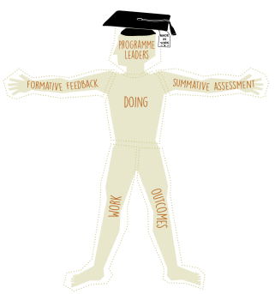

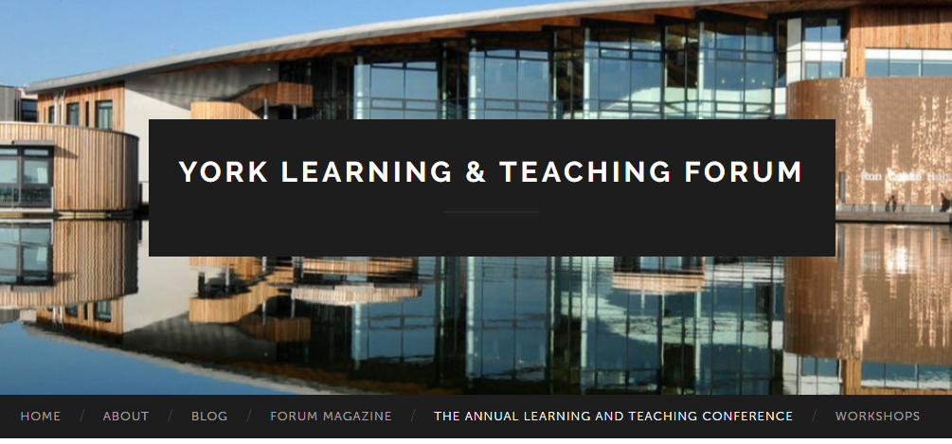
The York Pedagogy –
making it work
Value added graduates:
enabling our students to be successful
Twitter #YorkLT17
yorkforum.org

Slide 2
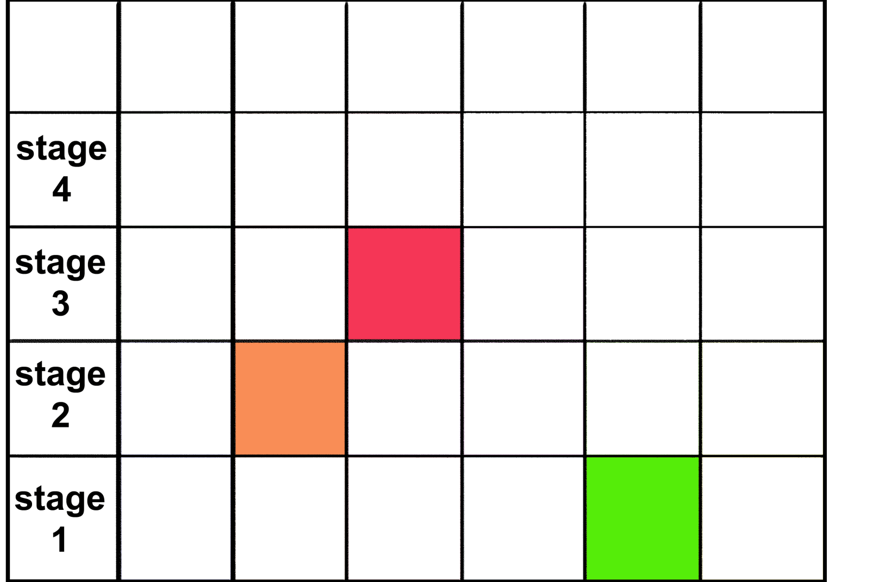
My view of the modules I deliver
Protectionist approach
I control scope for independent work, assessment, staff contact, student work
Learning outcomes linked to understanding and technical ability in module

Slide 3
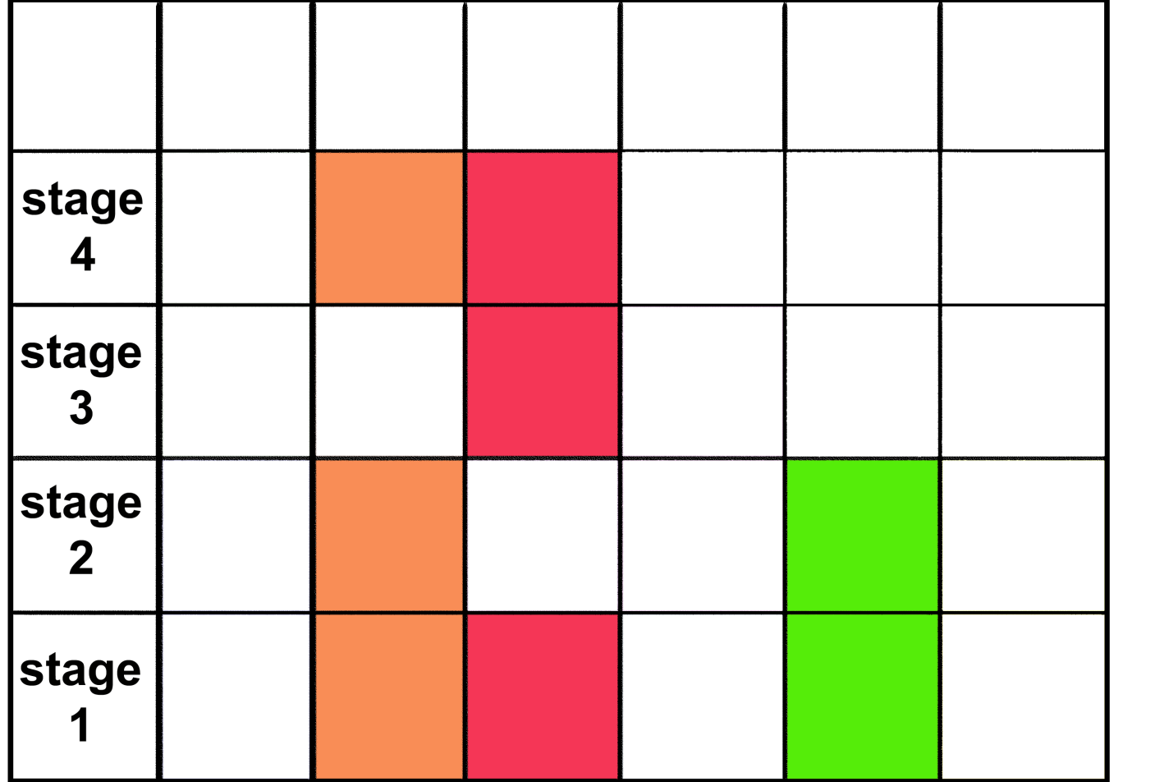
My view of the topic theme within which my module sits
I must work with colleagues to spread syllabus appropriately between stages
I build on the earlier module and cover pre-requisites for future module
Learning outcomes linked to understanding and technical ability in topic theme

Slide 4
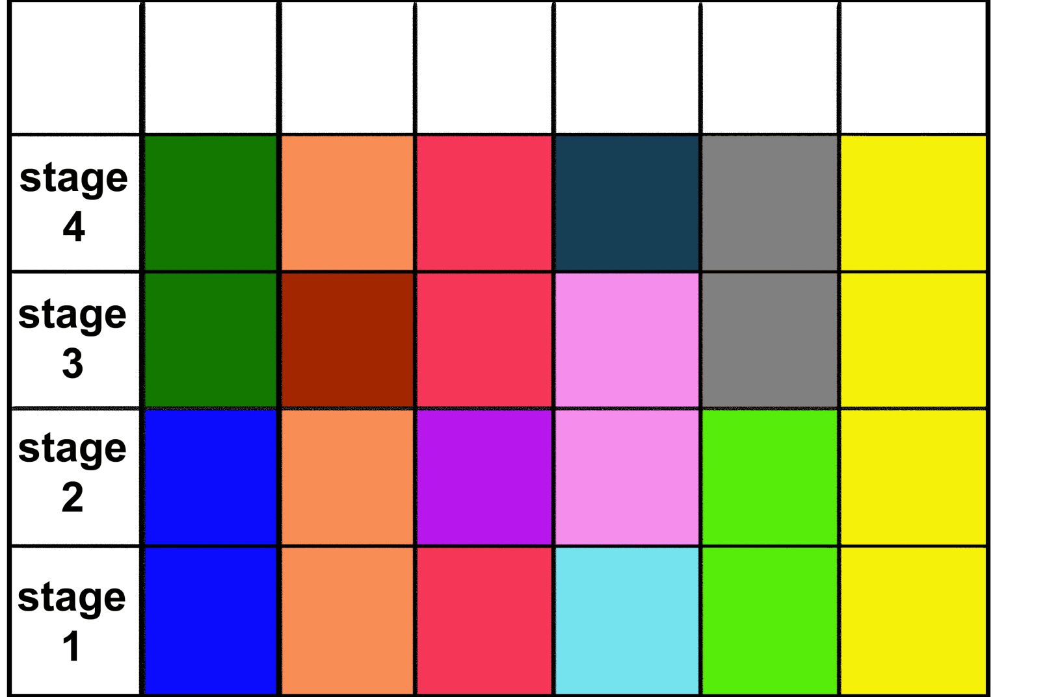
My view of the programme within which all modules sit
I see the jigsaw box lid and can see how my modules fit into the puzzle
I see development of syllabus and technical ability as vertical arrows
I appreciate how understanding and technical ability in one module is needed for another

Slide 5
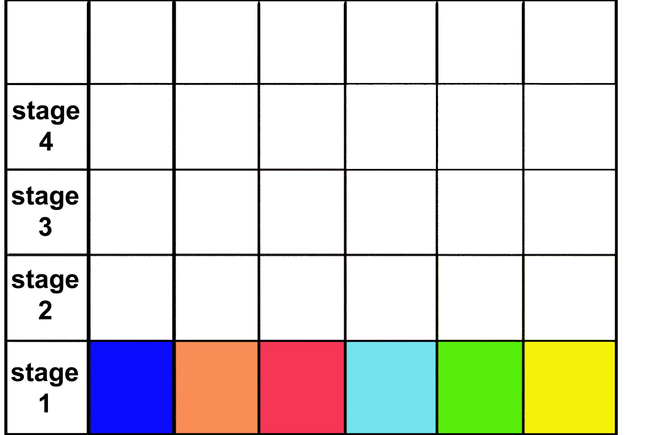
Students view of stage 1 teaching
Little concept of the jigsaw box lid (how, what and why we teach)
Heavily assessment driven approach to engaging with 6 stand-alone modules
Little concept of overall outcomes of the programme – what they can do as a graduate

Slide 6
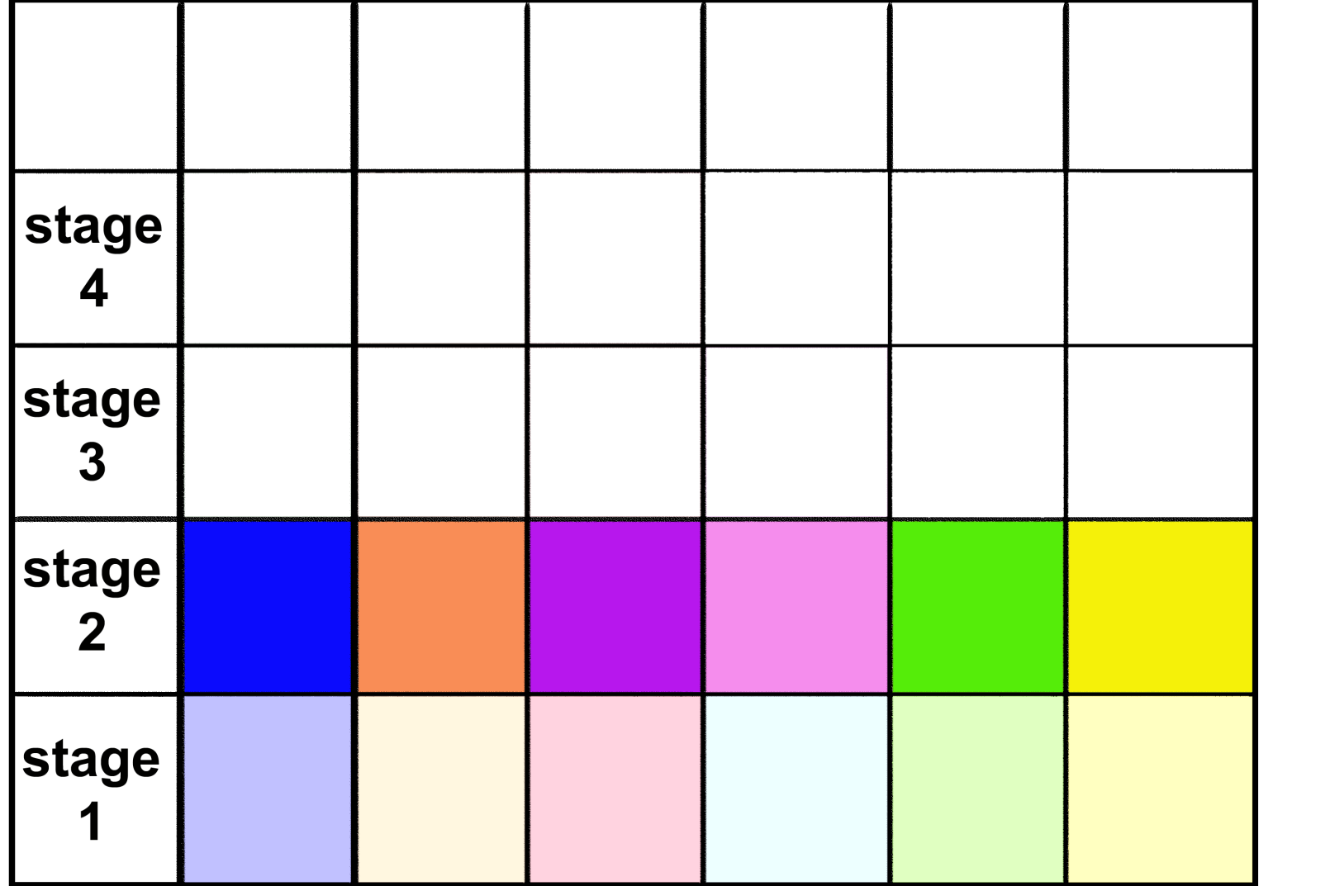
Students view of stage 2 teaching
Little concept of the jigsaw box lid (how, what and why we teach)
Heavily assessment driven approach to engaging with 6 stand-alone modules
Little concept of overall outcomes of the programme – what they can do as a graduate

Slide 7
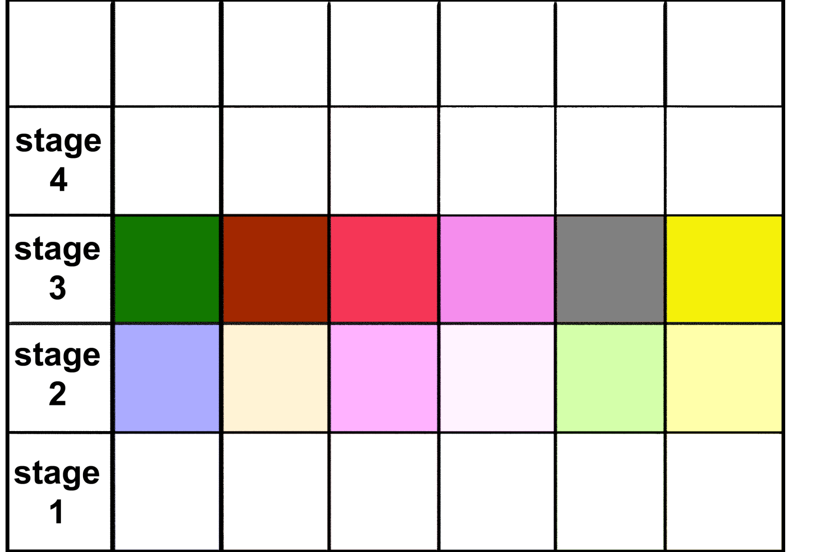
Students view of stage 3 teaching
Little concept of the jigsaw box lid (how, what and why we teach)
Heavily assessment driven approach to engaging with 6 stand-alone modules
Little concept of overall outcomes of the programme – what they can do as a graduate

Slide 8
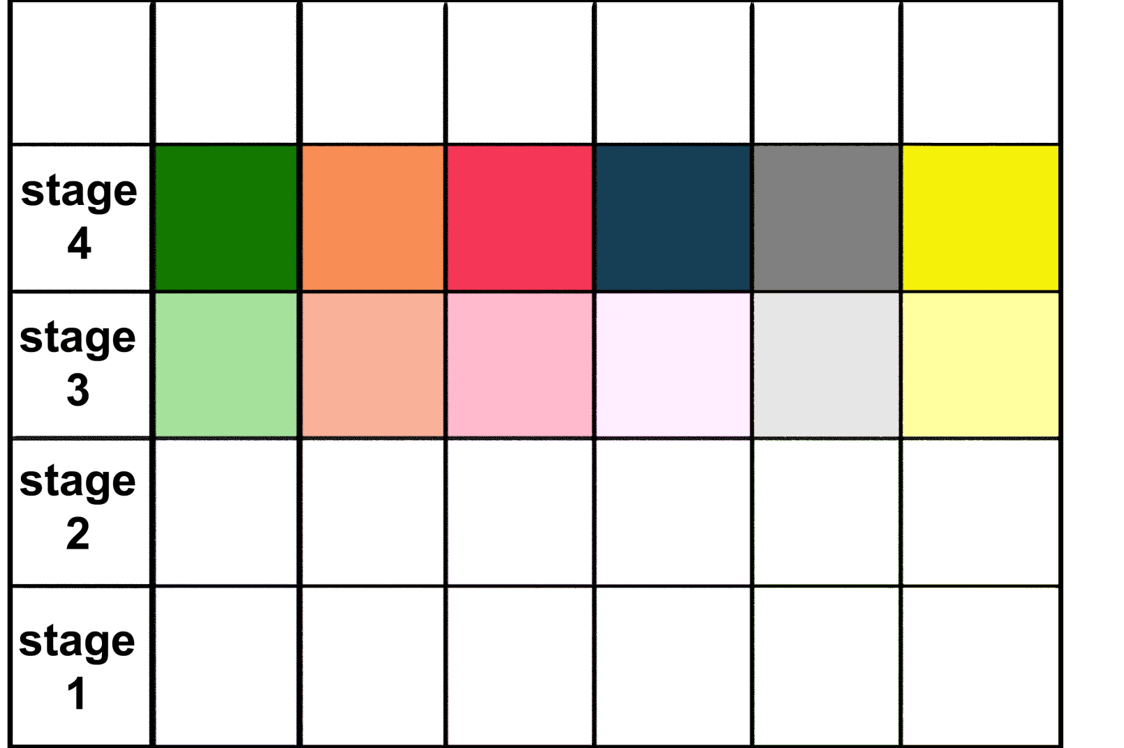
Students view of stage 4 teaching
Little concept of the jigsaw box lid (how, what and why we teach)
Heavily assessment driven approach to engaging with 6 stand-alone modules
Little concept of overall outcomes of the programme – what they can do as a graduate

Slide 9

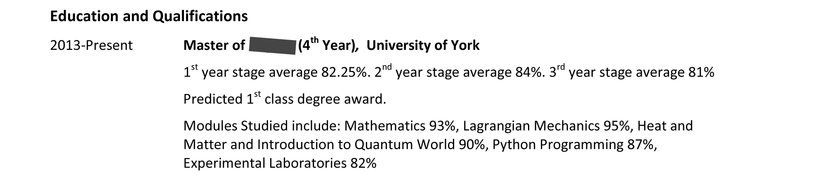
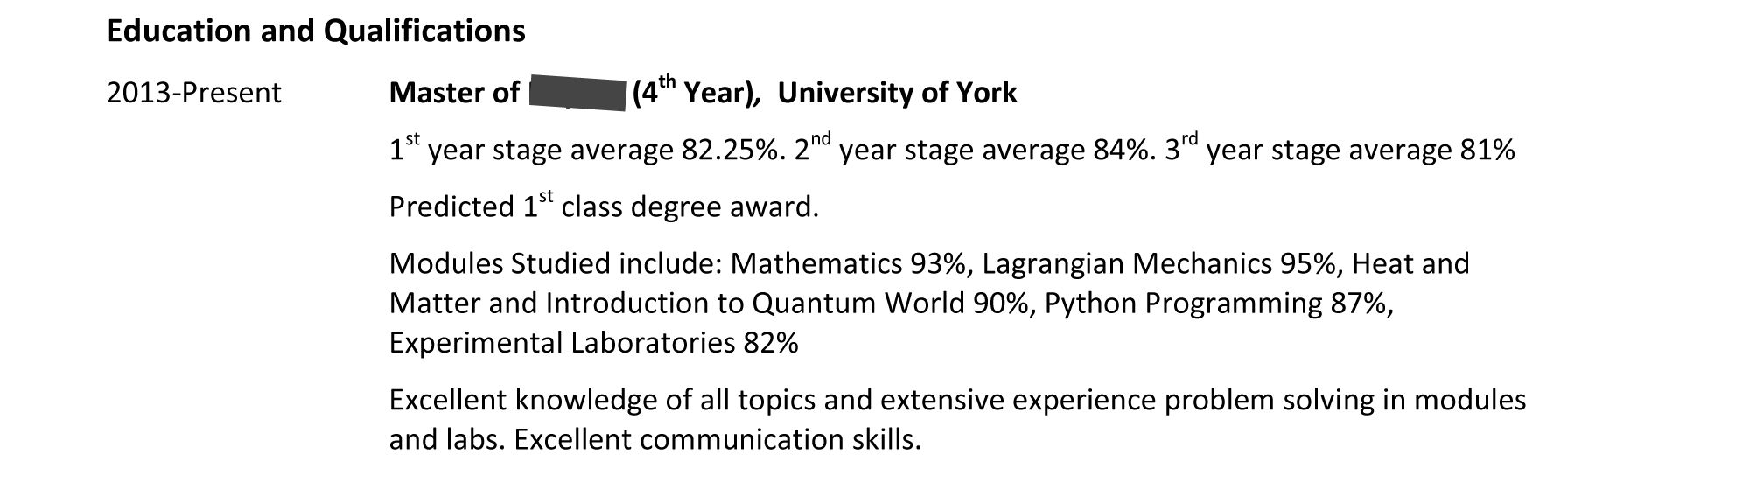
Genuine typical student CV examples

Slide 10
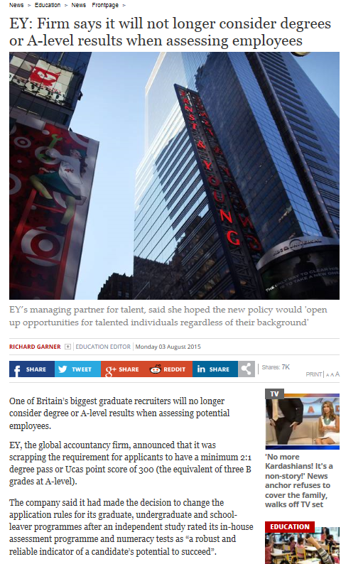

Competition and the value of the degree
Employers are looking for graduates with:
High Performance Behaviours (adaptable, resilient to change, work with others, critical thinking, problem solving, willingness to take responsibility)
Degree Apprenticeships
No training costs/university fees and participants receive a wage
New HE providers through HER Bill

Slide 11
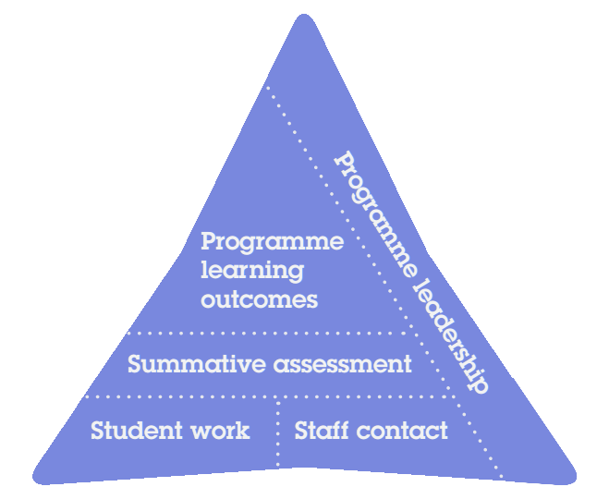
The York Pedagogy
PLOs - A set of 6 to 8 describe what a programme enables graduates to do, and these inform the design of all aspects of teaching within the programme. A programme map captures how learning abilities are developed through modules
Summative assessment - This remains located within individual modules but should be coordinated at programme level
Student Work - Within programmes explicit attention is given to all aspects of student work which support learning, independent study as well as contact with staff
Staff Contact - Programme design seeks to maximise the value of contact time with staff

Slide 12
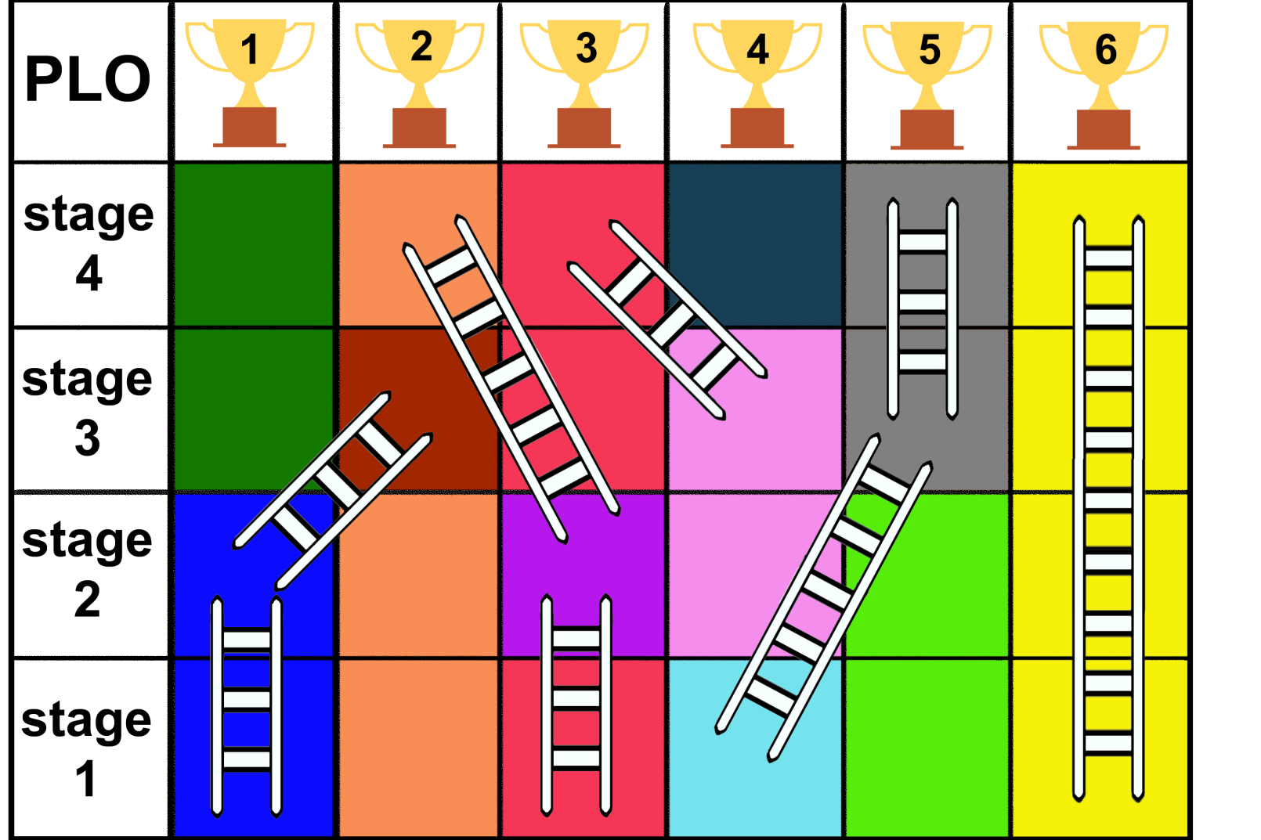
The York Pedagogy applied to the programme
Jigsaw box lid (how, what and why we teach) is visible and clarifies programme objectives to staff and students
The programme map continually evolves guiding us to question how the modules contribute to the PLOs

Slide 13



Evolution of The York Pedagogy
Is it a tombstone for a 3 year project which died in 2017?
Is it a set of rules which must have to be begrudgingly followed?
Is it a straight jacket whose map constrains future changes?
Making It Work
Embed it in what we do
Gain staff buy-in
Challenge the map

Slide 14
The York Pedagogy –
making it work
10.00-10.20am: Welcome!
10.30-11.30am: Workshop A (five concurrent sessions) in Exhibition Centre
11.40-12.40pm: Workshop B (five concurrent sessions) in Exhibition Centre
12.45-1.30pm: Posters and lunch in Spring Lane Building (Ground + 1st floor)
1.40-2.55pm: Keynote address and discussion, SLB118
Pedagogy and Curiosity: How we can offer a distinctive research-intensive learning experience through the Pedagogy
Prof John Robinson, PVC for Teaching, Learning and Students
3.00-3.35pm: Poster session and afternoon tea in SLB (Ground + 1st floor)
3.40-4.40pm: Plenary (concurrent sessions) split by faculty, chaired by Faculty Co-ordinators in Exhibition Centre
The plenary will attempt to capture your thoughts regarding the implementation and evolution of The York Pedagogy.

