Slide 1
Pedagogy and Curiosity
John Robinson
Pro-Vice-Chancellor Learning, Teaching and Students
Annual Learning and Teaching Conference, 20 June 2017
University of York

Slide 2
Agenda
Origins
The themes of the York Pedagogy
Values
The York Pedagogy in Practice
Virtue

Slide 3
Agenda
Origins
The themes of the York Pedagogy
Values
The York Pedagogy in Practice
Virtue

Slide 4

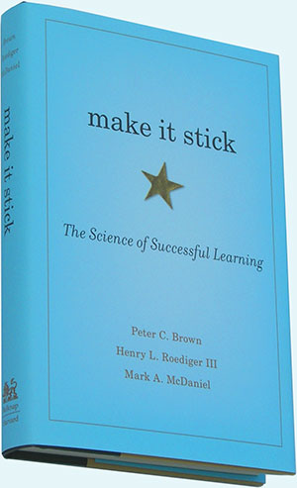
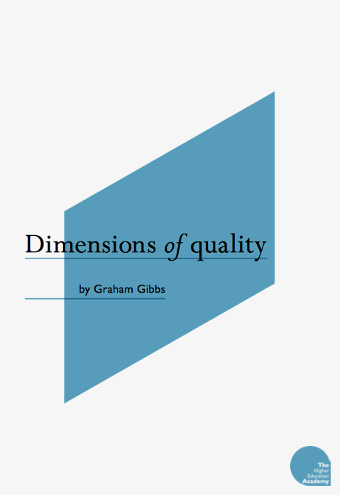
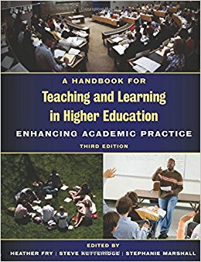

Research

Slide 5
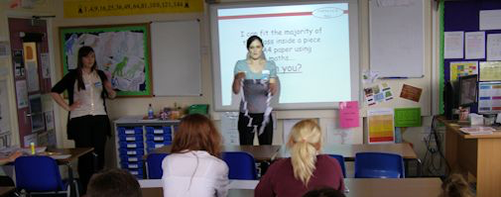
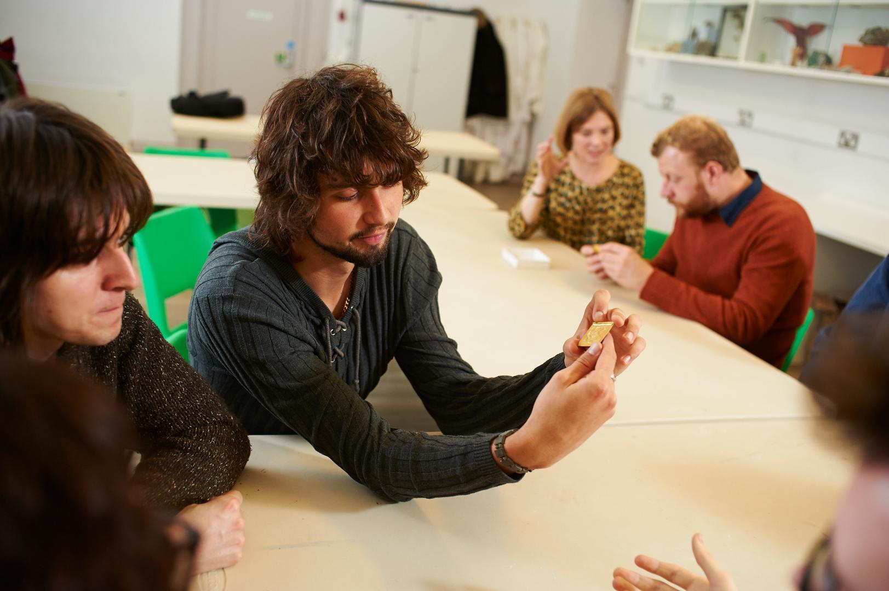


Heritage

Slide 6
Defining a Framework for the Design of Learning

Slide 7
Defining a Framework for the Design of Learning
General, durable, flexible
Doable
Sustainable / Evolvable
Tactically aware
Distinctive
Concise, concrete, credible

Slide 8
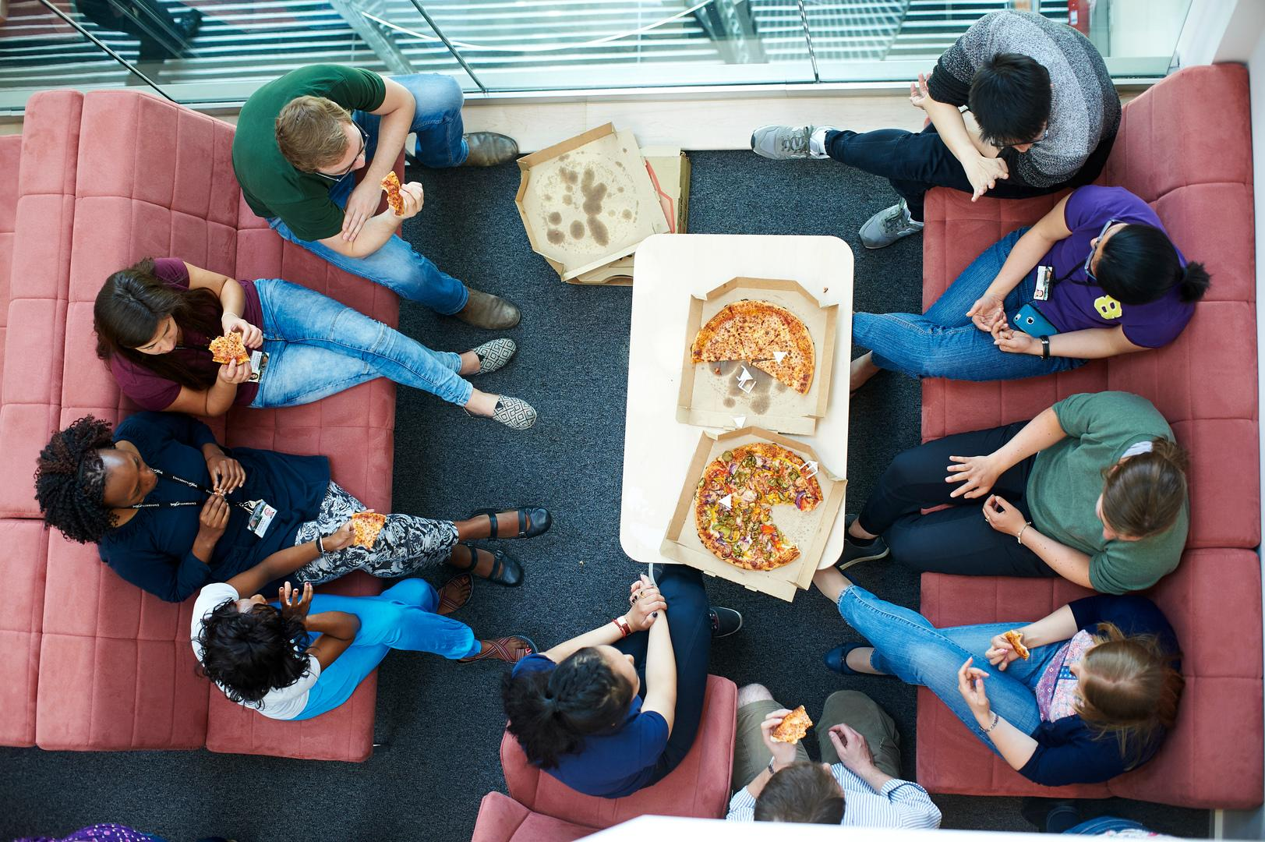
Collaboration, collegiality and tidiness

Slide 9
Agenda
Origins
The themes of the York Pedagogy
Values
The York Pedagogy in Practice
Virtue

Slide 10
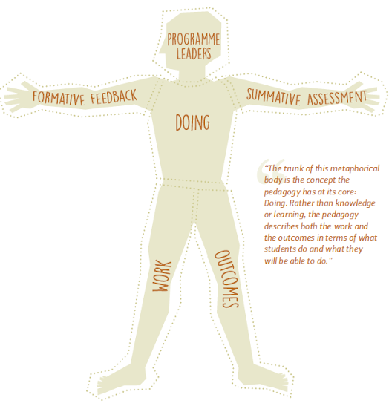
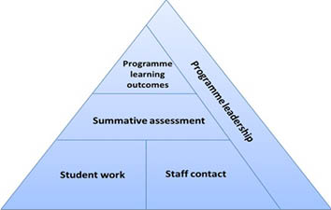
Summarising the themes

Slide 11
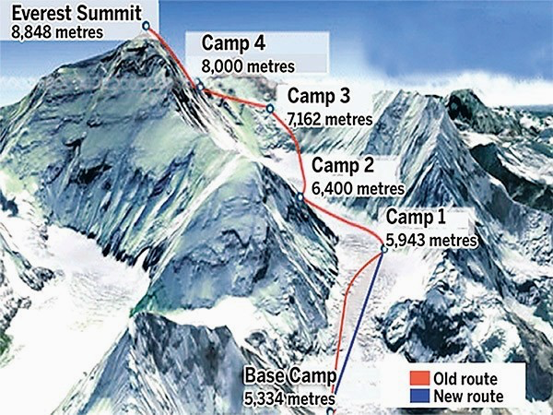
Ascent

Slide 12
Ascent

Slide 13
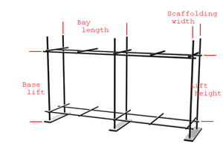
Ascent

Slide 14
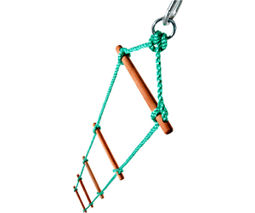
Ascent

Slide 15
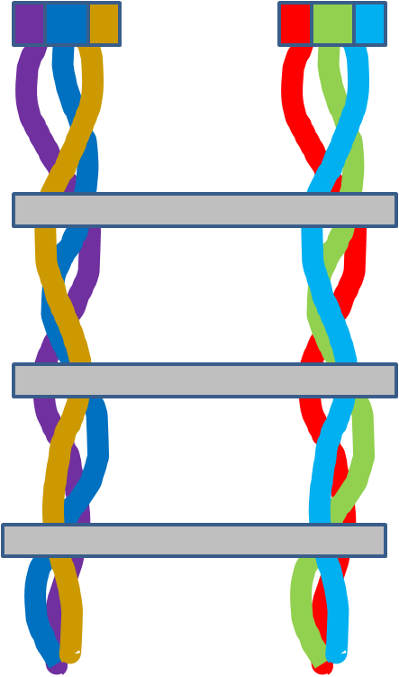
Ascent

Slide 16

Work

Slide 17
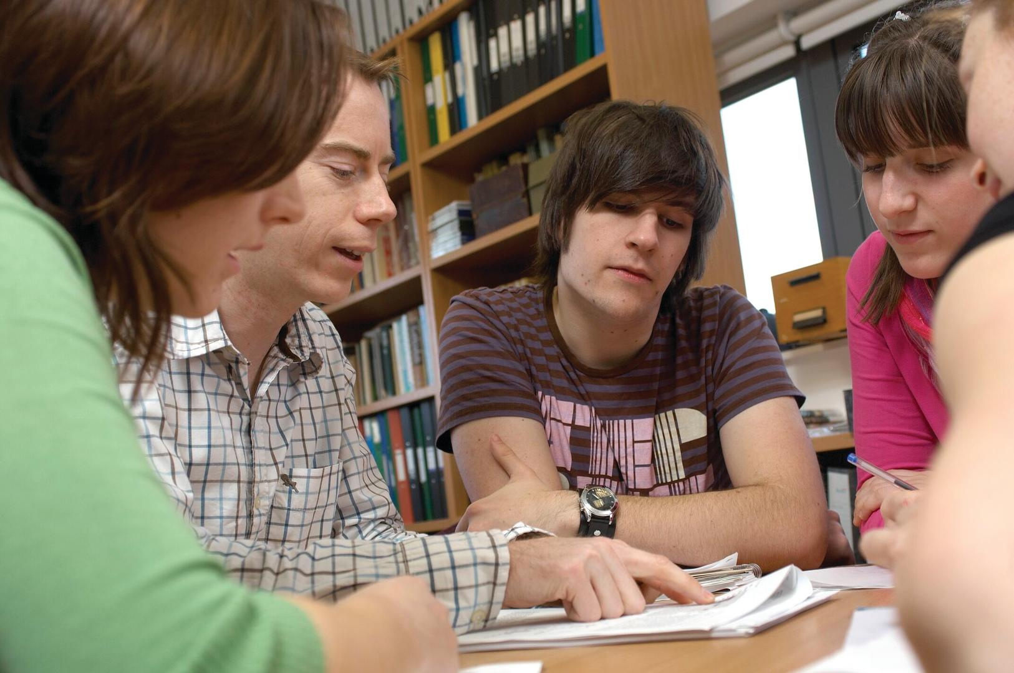
Propelling student work

Slide 18
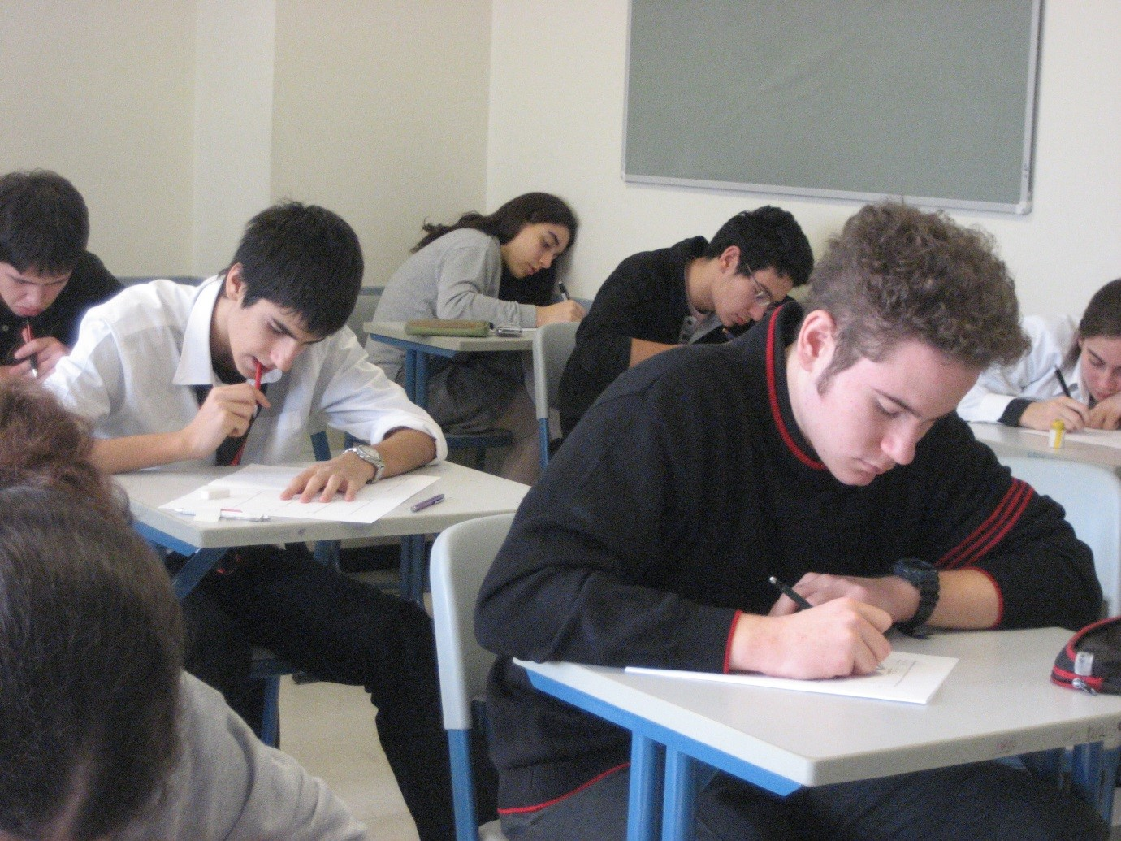
Assessment

Slide 19
Leadership

Slide 20
Agenda
Origins
The themes of the York Pedagogy
Values
The York Pedagogy in Practice
Virtue

Slide 21
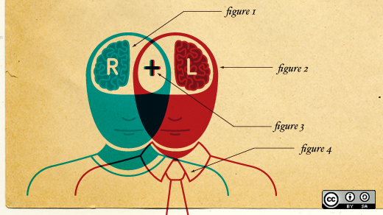
Design

Slide 22
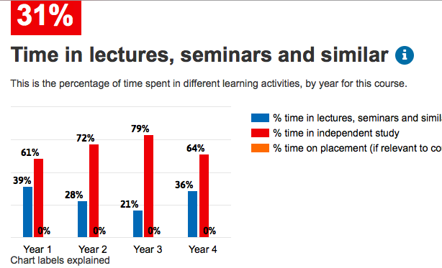
Explanation

Slide 23
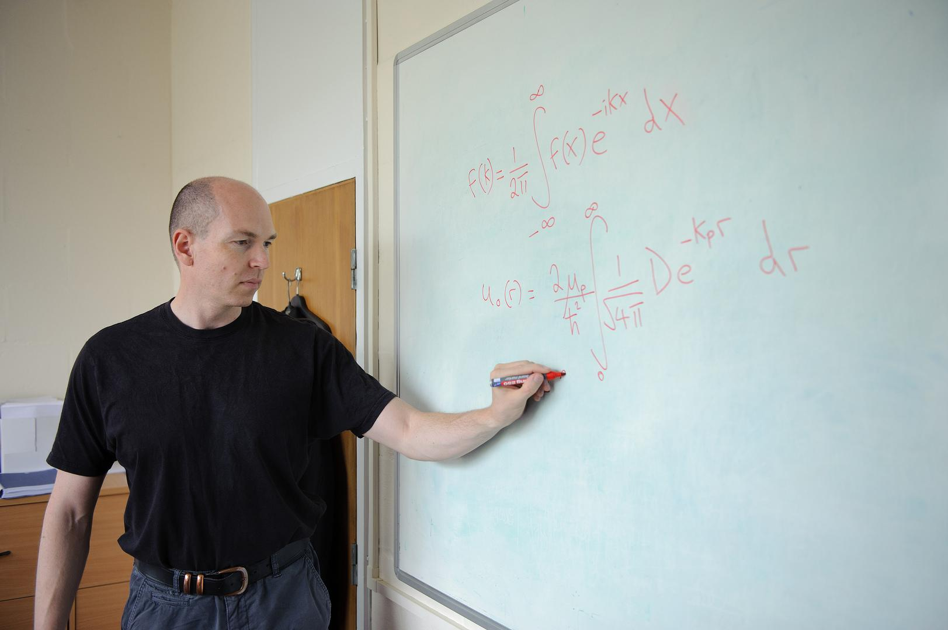
Those who teach… are those who design

Slide 24
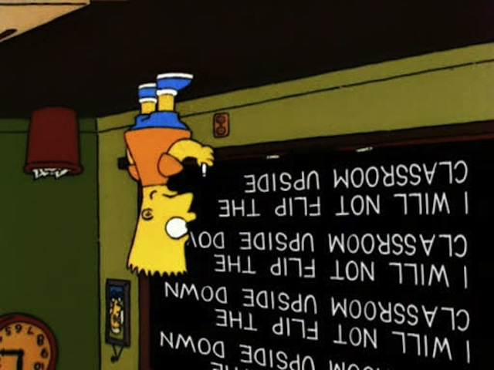
Stretch

Slide 25
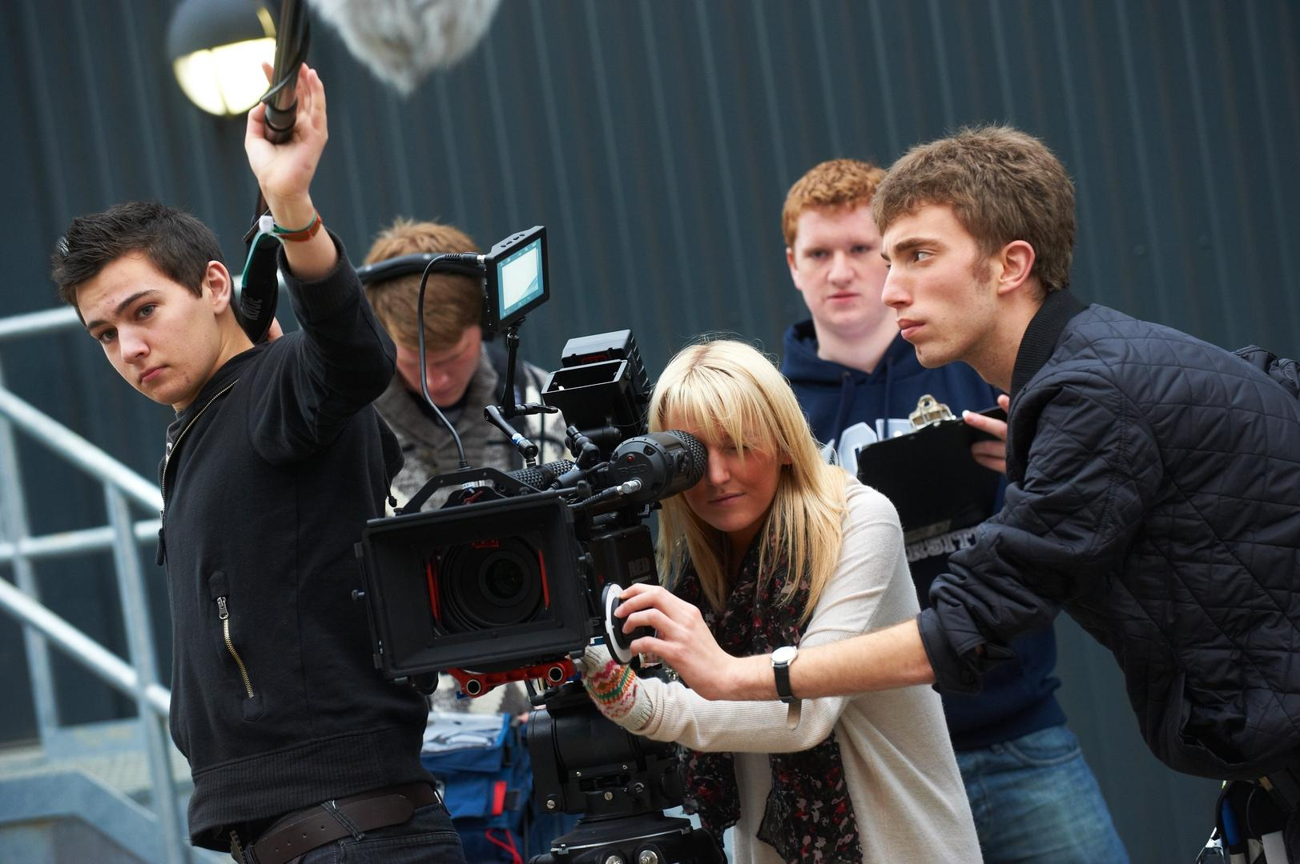
Expertise

Slide 26
Agenda
Origins
The themes of the York Pedagogy
Values
The York Pedagogy in Practice
Virtue

Slide 27
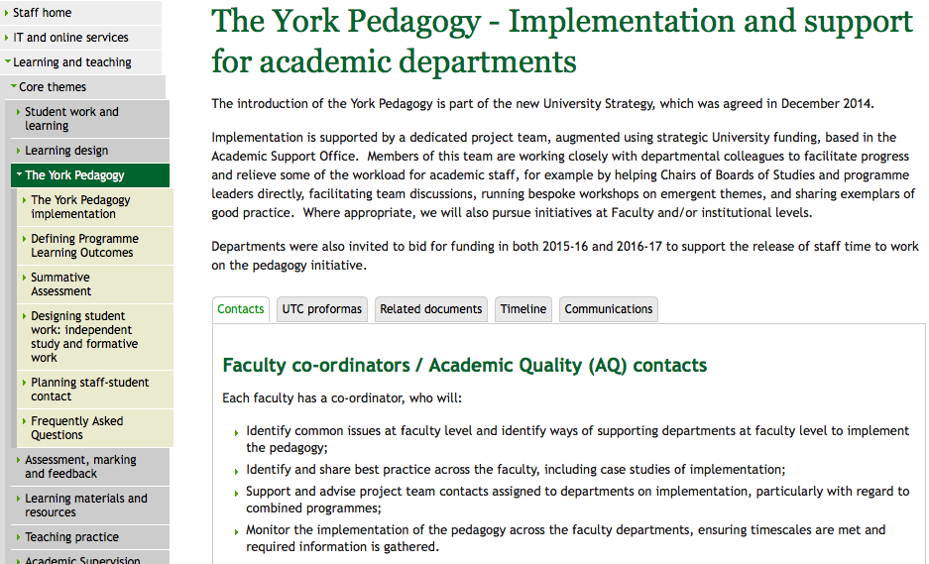

Slide 28
The ProPEL Team
Katy Mann Benn
Cecilia Lowe
Richard Walker
Madeleine Mossman
Wayne Britcliffe
Duncan Jackson
Phil Robinson-Self
David Gent
Stephen Gow
Juliet James
Francis Duah
Susan Halfpenny
Tamlyn Ryan
Maeve Pearson
Jane Iddon
Adrian Lee
Andrea Boam
Jenny Brotherton
Nigel Dandy

Slide 29
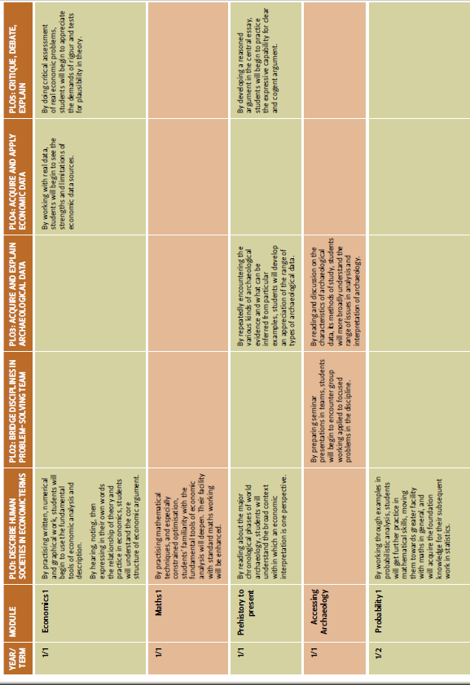
The Documents

Slide 30
Zoomable Documents
Origins
  Make the best of recent robust research
  Make the best of what York already does and has to offer
  Provide a framework for design of learning
  Collaboration and collegiality and the tension with simplicity
The themes of the York Pedagogy
  Two diagrams that summarise the themes: The triangle and the person. The triangle evokes climbing a mountain…
  Ascent. Implies journey coherence. Metaphor not of slabs making steps (in compression) but of rope ladder (in tension, anchored at the top).
  Student work. Higher rungs on the learning ladder can be further apart if students become better climbers. Design student work to optimise growth of learning ability.
  Contact hours propelling student work. Formative feedback is coaching in learning.
  Assessment / evaluation.
  Programme leadership
Values
  Design at the heart: Structure for creativity. Teaching as a creative act.
  Explanation: Why doing this? E.g. lower contact hours justified if they propel learning during what students do outside contact hours. Things don’t happen by accident.
  Academics in charge. Not someone from the skills police with a tickbox. People absorbed in the subject are best able to design programmes.
  Encouraging learning design stretch. Framework and process stimulate discussion of alternatives, get Learning Enhancement into depts..
  Role of expertise: Want graduates to be high performers and gain respect for the facility of their ability. Deep question involving what things we ask students to do repeatedly and how we coach them. For the most abstract subjects, what things need to be practiced so ability is in the fingertips, leaving space for creativity? Dan Heath: “Practice makes permanent” (Shampooing). The true divide between training and education is that education seeks to understand the known/practiced boundary.
The York Pedagogy in practice
  The resources
  The ProPEL team
  Major docs:
    PLOs: Concise, concrete well-received and successful. Some convergence between disciplines but the subject matter counts.
    Credible: The blueprint. I.e. the map. Zoomable like an ordinary map. Variable success. Will say more later.
  Pros and cons of “compliance”
  Now beginning first stage of review.
    One answer we think we know already. Have to have software tool to aid coherent design. Programme catalogue.
Virtue
  The Pedagogy talks about what you can do, not what you can be. Leader? Global citizen? Influential? Prosperous and Generous? We’d like our graduates to be, but can’t guarantee. Lifelong learner better but still not quite right. It sounds like someone who is going to keep taking courses.
  If we could have a virtue that graduates will be, what would we choose? We want our graduates to be curious.
  Parallel to Stay Hungry, Stay Foolish. Rhetorically weaker, but clearer: Curiosity means wanting to find out things.
  Barriers to curiosity and some props (because we’re not saints!)
  Pedagogy sustainability depends on it being right-sized for curiosity.
  Research intensivity. Surface level: Exposure to the doing of research. Deeper level: Exposure to people passionate about subject. Deepest level: Curiosity (under challenge)

Slide 31

The pros and cons of “compliance”

Slide 32



Embedding, review, learning, evolving

Slide 33
Agenda
Origins
The themes of the York Pedagogy
Values
The York Pedagogy in Practice
Virtue

Slide 36
Three Einstein Quotes (Reportedly)
It is a miracle that curiosity survives formal education.
The important thing is not to stop questioning.
I have no special talent. I am only passionately curious.

Slide 37
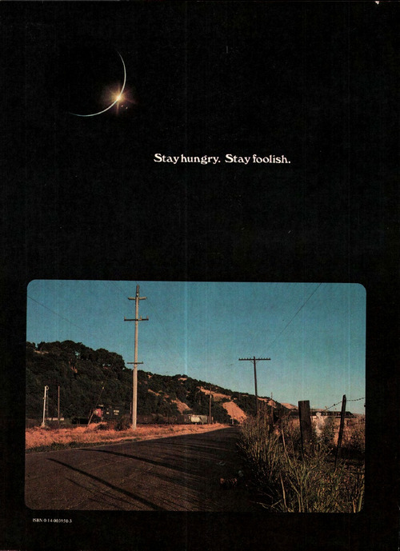

Slide 38
Impediments to curiosity
Rigidity
Convention
Timidity
Posturing
Laziness

Slide 39
Impediments to curiosity … and some props
Rigidity
Convention
Timidity
Posturing
Laziness
Diversity of concepts, interpretations, sources
Defining and crossing conceptual gulfs
Encouragement, engaging teaching
Reasoning and rhetoric
We see these in PLOs and maps

Slide 40
The York Pedagogy and Curiosity

Slide 41
The York Pedagogy and Curiosity
We want frameworks that go on prompting: What if…? Why is it like that? How can we make it better?
Concise, concrete, credible: Right-sized for curiosity
What and why, how and why
What and why (PLOs) --- New destinations? Continuing relevance? Ambitions met?
How and why (Maps) --- What if we…? How to rewire modules to get the most effective cascade of learning abilities? What new routes do we see?
The research-intensive bonus

Slide 42
The York Pedagogy and Curiosity
We want frameworks that go on prompting: What if…? Why is it like that? How can we make it better?
Concise, concrete, credible: Right-sized for curiosity
What and why, how and why
What and why (PLOs) --- New destinations? Continuing relevance? Ambitions met?
How and why (Maps) --- What if we…? How to rewire modules to get the most effective cascade of learning abilities? What new routes do we see?
The research-intensive bonus

Slide 43
The York Pedagogy and Curiosity
We want frameworks that go on prompting: What if…? Why is it like that? How can we make it better?
Concise, concrete, credible: Right-sized for curiosity
What and why, how and why
What and why (PLOs) --- New destinations? Continuing relevance? Ambitions met?
How and why (Maps) --- What if we…? How to rewire modules to get the most effective cascade of learning abilities? What new routes do we see?
The research-intensive bonus

Slide 44
The York Pedagogy and Curiosity
We want frameworks that go on prompting: What if…? Why is it like that? How can we make it better?
Concise, concrete, credible: Right-sized for curiosity
What and why, how and why
What and why (PLOs) --- New destinations? Continuing relevance? Ambitions met?
How and why (Maps) --- What if we…? How to rewire modules to get the most effective cascade of learning abilities? What new routes do we see?
The research-intensive bonus (and challenge)

Slide 45
Picture credits
Everest ascent diagram from nepalmountainnews.com
Scaffolding picture from Wikimedia commons
Assessment photo from the University of Bath website
Keep calm picture from medwebexperts.co.za
Simpson’s chalkboard gag from bagtheweb.com
Anders Ericsson portrait from businessinsider.com
Design diagram from censemaking.com on Wordpress
Stuart Brand’s Whole Earth Catalog 1974 back cover from The Long Now blog (longnow.org), citing the Point Foundation.
Book covers taken from goodreads.com or amazon.co.uk
KIS widget from Unistats. (The programme illustrated is a York degree.)
TEF metrics for York from HEFCE.
All other pictures University of York Image Library, or York Learning and Teaching webpages, or by John Robinson.

