Slide 1
Enabling active learning through technology:
Use cases, instructional design & delivery responsibilities
Dr Richard Walker
Wayne Britcliffe

Slide 2
Session Outline
Defining active learning
  How does this fit with the York Pedagogy?
Identifying opportunities to design in student-led activities using technology
  Discussion
Review of course design approaches and activity modes at York
Facilitating student-led teaching and content creation activities
  Instructional responsibilities and things to think about

Slide 3
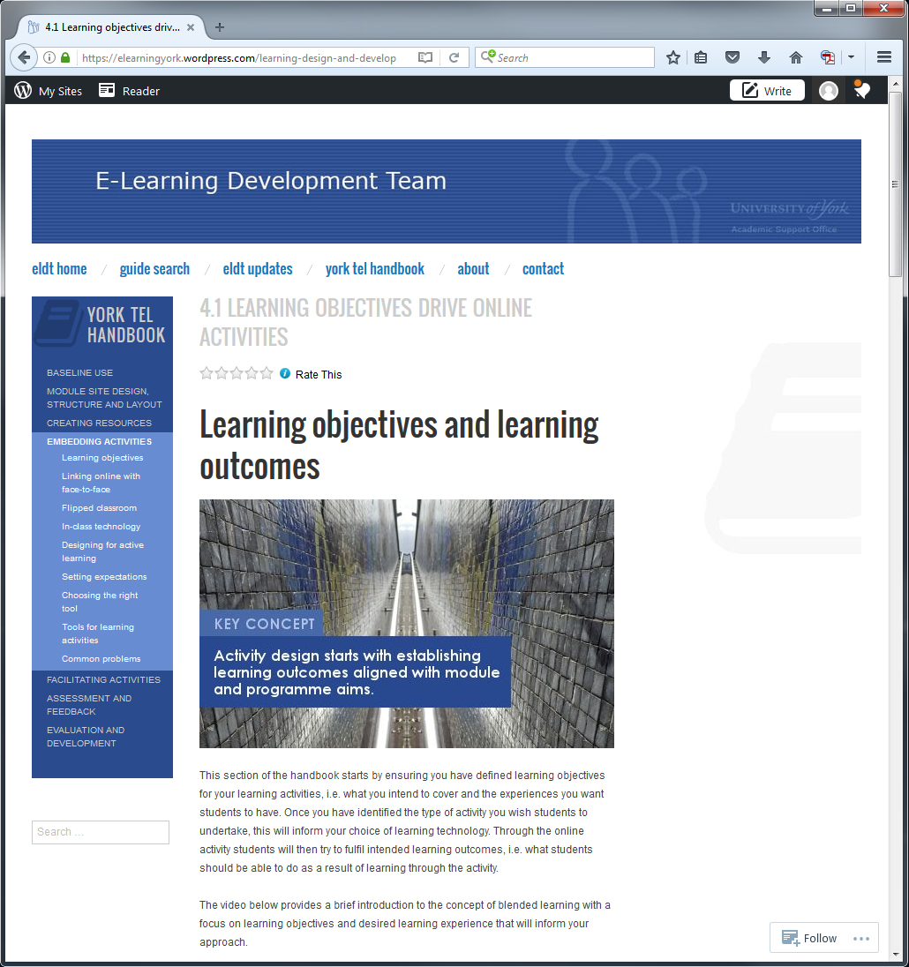
Programme-level design and renewal
York Pedagogy:
Explicit attention to all aspects of student work: independent study and formative tasks
Focus on active learning design – developing students as autonomous learners
  enabled through technology: designed in and aligned with learning objectives
  supporting different modes of learner engagement, activity and control
Notes:
Defining student-led teaching and content creation
The York Pedagogy is a new institutional pedagogy for the design of learning and teaching. It encourages instructors to design in to their courses meaningful study activities which offer active learning opportunities to students to help propel their learning across a study programme.
The University’s vision for the use of learning technologies underpins this design approach. The use of technologies should facilitate learning and provide opportunities for students to rehearse and articulate their knowledge as part of their independent study. Guidance on how to make use of the supported tool-set to meet these goals is provided through a number of sources including the York TEL Handbook (as illustrated in the screenshot) – using curriculum design language to help academics make the connection between curriculum design goals and usage of TEL tools.
Learning technologies are therefore presented as enabling tools, which support different modes of learner engagement and activity and increasing levels of student-led activity and control across a study programme. In this way technology should be designed in to programmes and individual modules to support pedagogically appropriate activities which are relevant to the stage of learning that a student has reached.

Slide 4
Modes of learner engagement supported through the use of technology
Engagement Mode
Illustrative Activities
TEL support
Enabling learning: interleaved practice
retrieval of previously learned material;
application to new contexts
formative quizzing;
targeted online feedback
and support
Enhancing learning: insight through structured interaction
dialogical learning and collaborative research and report writing tasks
wiki /blog spaces
online peer, assessment and review
Transforming learning: student-led teaching and discovery
Student-led content creation;
problem-based learning
resource hub
wiki / blog problem
solving space
Notes:
This slide presents a selection of the modes of learner engagement that may be supported through the use of technology. These modes vary in terms of the levels of responsibility and task ownership that are required of the student to engage with the proposed online activities – but reflect different components of active learning which we may wish to see included in programme design. – i.e. from application/transfer of learned material to new contexts, through to activities which encourage students to author and develop their own learning and teaching resources.
Interleaved practice may be supported through formative quizzing, with students testing their knowledge by responding to a randomly generated selection of questions from a question bank.
Structured interaction could be based around a collaborative research and writing task, with groups assigned wiki and blog tools to help present their findings.
Learning technologies can also support student-led teaching and content creation tasks – the focus of this lunchtime webinar - as well as guided / unguided problem solving tasks through the use of a prescribed set of resources.

Slide 5
Towards user-led education
Transformative learning
Enabling learning
Enhancing learning
Active Learning and Engagement
Increasing flexibility
and access to learning
Extending range of learning opportunities
Nomadic & situated (context aware) learning
Facilitating discussion and peer support
Student-authored teaching resources
Student-led learning through collaboration & communities of inquiry
Notes:
Another way of thinking about the design of online tasks is to plot them on a spectrum of active learner engagement and autonomy – with increasing levels of activity and engagement in the performance of the tasks. The image in this slide offers examples of the range of online tasks that could be considered and the level of engagement required, from scaffolded tasks such as the completion of formative self-study quizzes (which are well structured for students to complete with in-built feedback and guidance), through to student-led teaching and the creation of course artefacts which require a greater level of autonomy and ownership by learners in their performance.

Slide 6
Students as producers of content
Re-envisioning role of students: producers rather than consumers of learning
Acknowledgement that students have skills to:
  Engage in collaborative knowledge creation activities
  Develop learning as active producers of ‘content’ (Generation ‘C’)
(Bruns et al., 2007; Dziuban, Hartman & Moskal, 2004)
Leading to hybrid ‘user-and -producer’ role
  including collaboration in content creation through teams and wider learning community
(Bruns, 2006)
Notes:
User-led design reflects a paradigm shift in pedagogic practice, re-envisioning the role of students as producers rather than consumers of learning. Implicit in this design approach is an acknowledgement that students have the skills and capability to engage in collaborative knowledge creation activities and develop their learning as producers of ‘content’ (Generation ‘C’). Generation C is distinctly different: it is the generation responsible for open source software development, music file-sharing, YouTube, Flickr, and the Wikipedia (Kaplan-Leiserson, 2005).
This philosophy is not particularly new - theories of learning such as social constructivism and collaborative models of teaching and learning have long been associated with educational transformation or paradigm shifts of this kind (Baets & Van der Linden, 2003; Dziuban, Hartman & Moskal, 2004).

Slide 7
Implications for learning and teaching
Designing for active learning:
  Focus on authentic learning activities
Developing students’ creative capacities and literacies
Addressing collaborative engagement in learning tasks
  communication skills and criticality in collaboration: through feedback and review

Slide 8
What do you see as the opportunities for the design of student-led learning and teaching activities at York?
Specifically activities that engage students as co-creators of learning resources / course artefacts?

Slide 9
Student-led learning & teaching activities
Use cases
Task Focus | Participation
 |  | Group Work | Individual Work
 | Procedural | Collaborative research summaries Question authoring (MCQ) & creation of solutions Peer review (critiquing of academic writing) | Dissemination of research findings (video production / social media) Literature reviews (opinion pieces)
 | Assessed | Unguided group research tasks (problem solving)
Notes:
We will briefly describe some examples of transformative course design approaches, in which students take direct control over their learning process through student-led teaching and discovery based learning approaches.

Slide 10
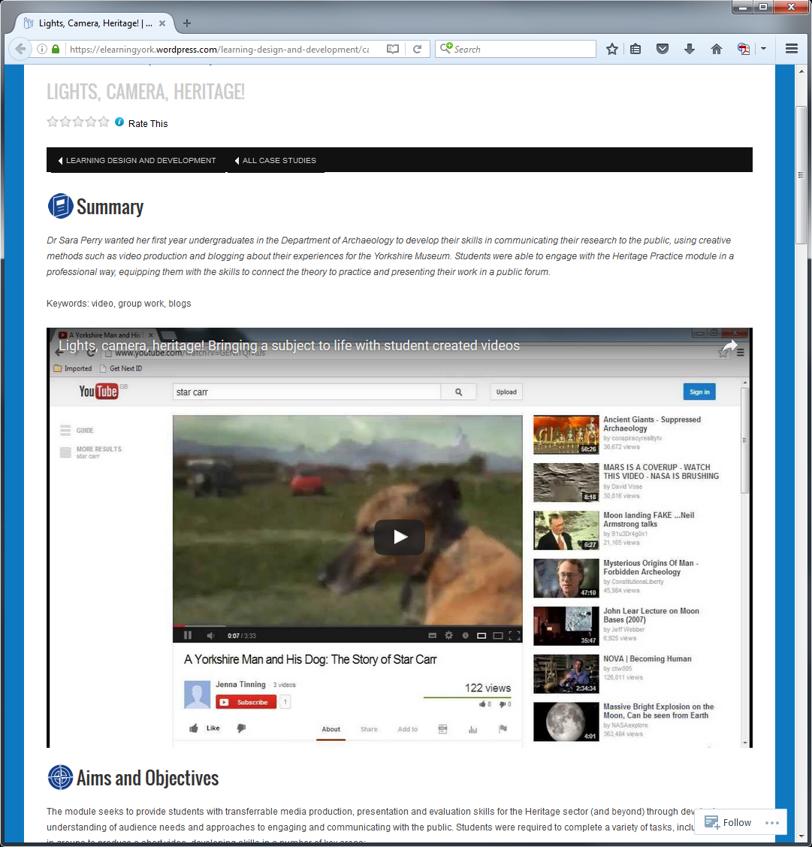
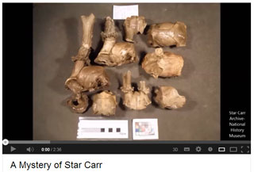
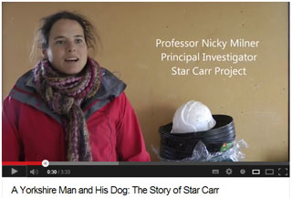
Transforming learning through student-created content (Video)
http://tinyurl.com/student-videos-blogging
Heritage Practice (Archaeology)
  Communicating research through video production and blogging
http://tentativestepsheritage.blogspot.co.uk/
http://yorkstudentheritage.blogspot.co.uk/
Notes:
Dr Sara Perry wanted her first-year undergraduates in the Department of Archaeology to develop their skills in communicating their research to the public, using creative methods such as video production and blogging about their experiences for the Yorkshire Museum. Students were able to engage with the Heritage Practice module in a professional way, equipping them with the skills to connect the theory to practice and presenting their work in a public forum.
http://tinyurl.com/student-videos-blogging

Slide 11
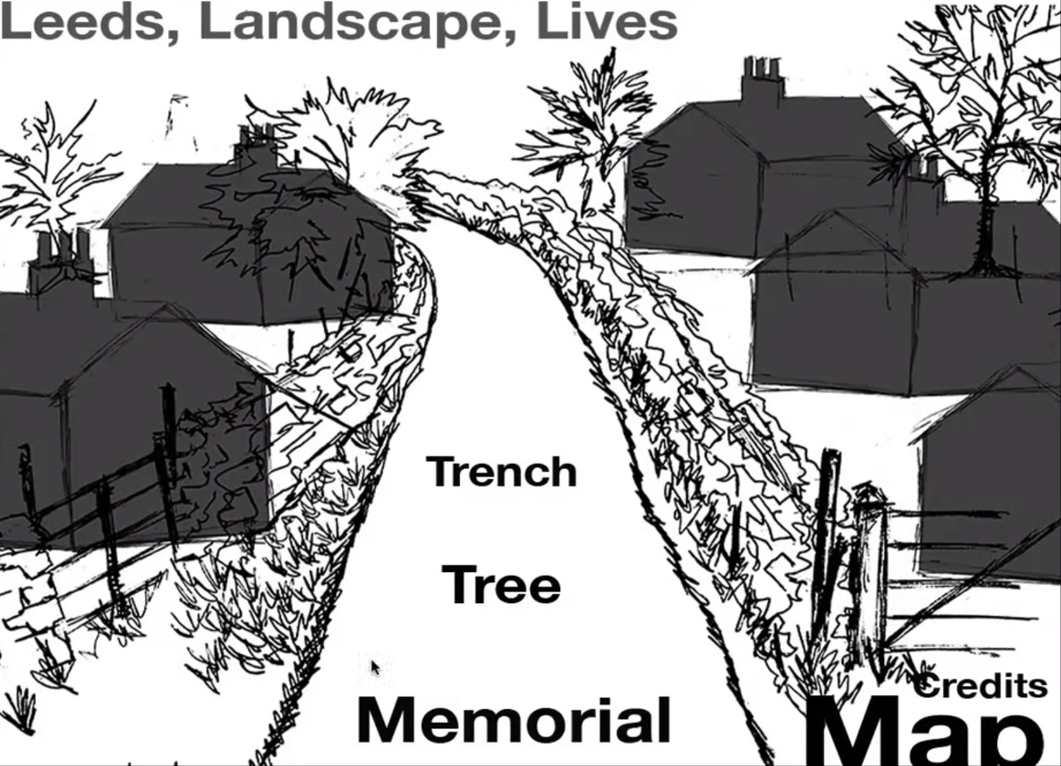
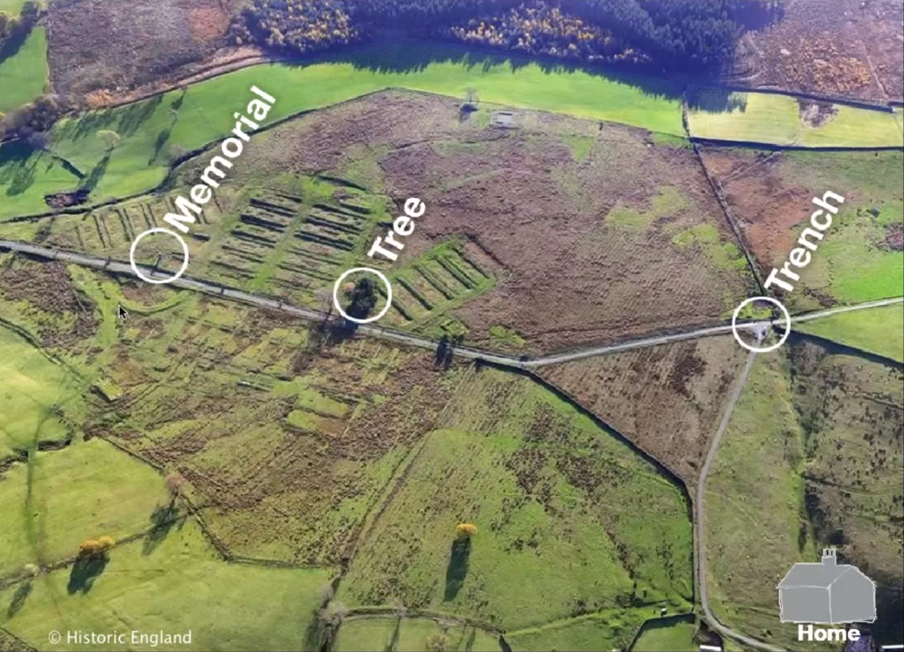
Heritage Practice
Prototype mobile app for Breary Banks
https://www.youtube.com/watch?v=DspvqI4UJ_k&feature=youtu.be
Notes:
https://www.youtube.com/watch?v=DspvqI4UJ_k&feature=youtu.be

Slide 12
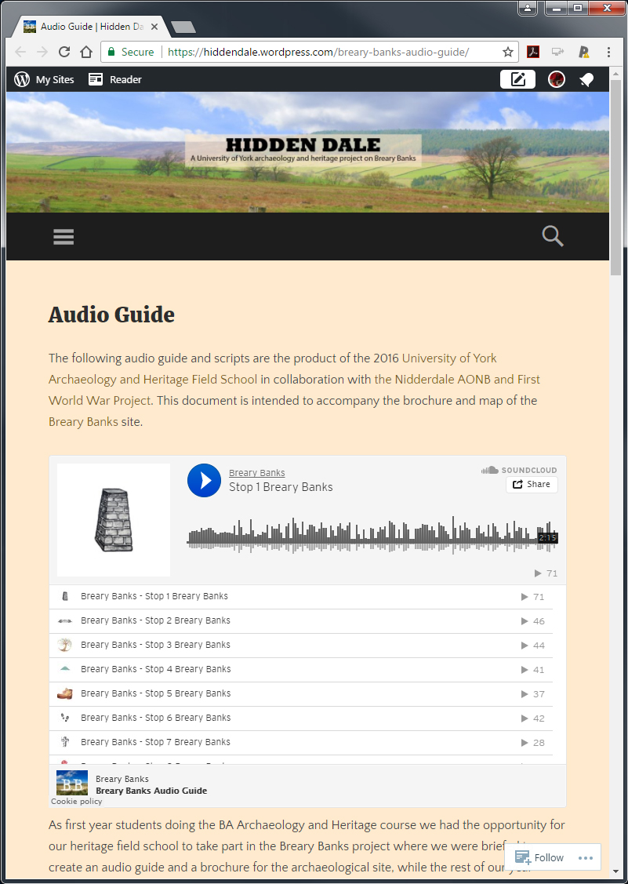
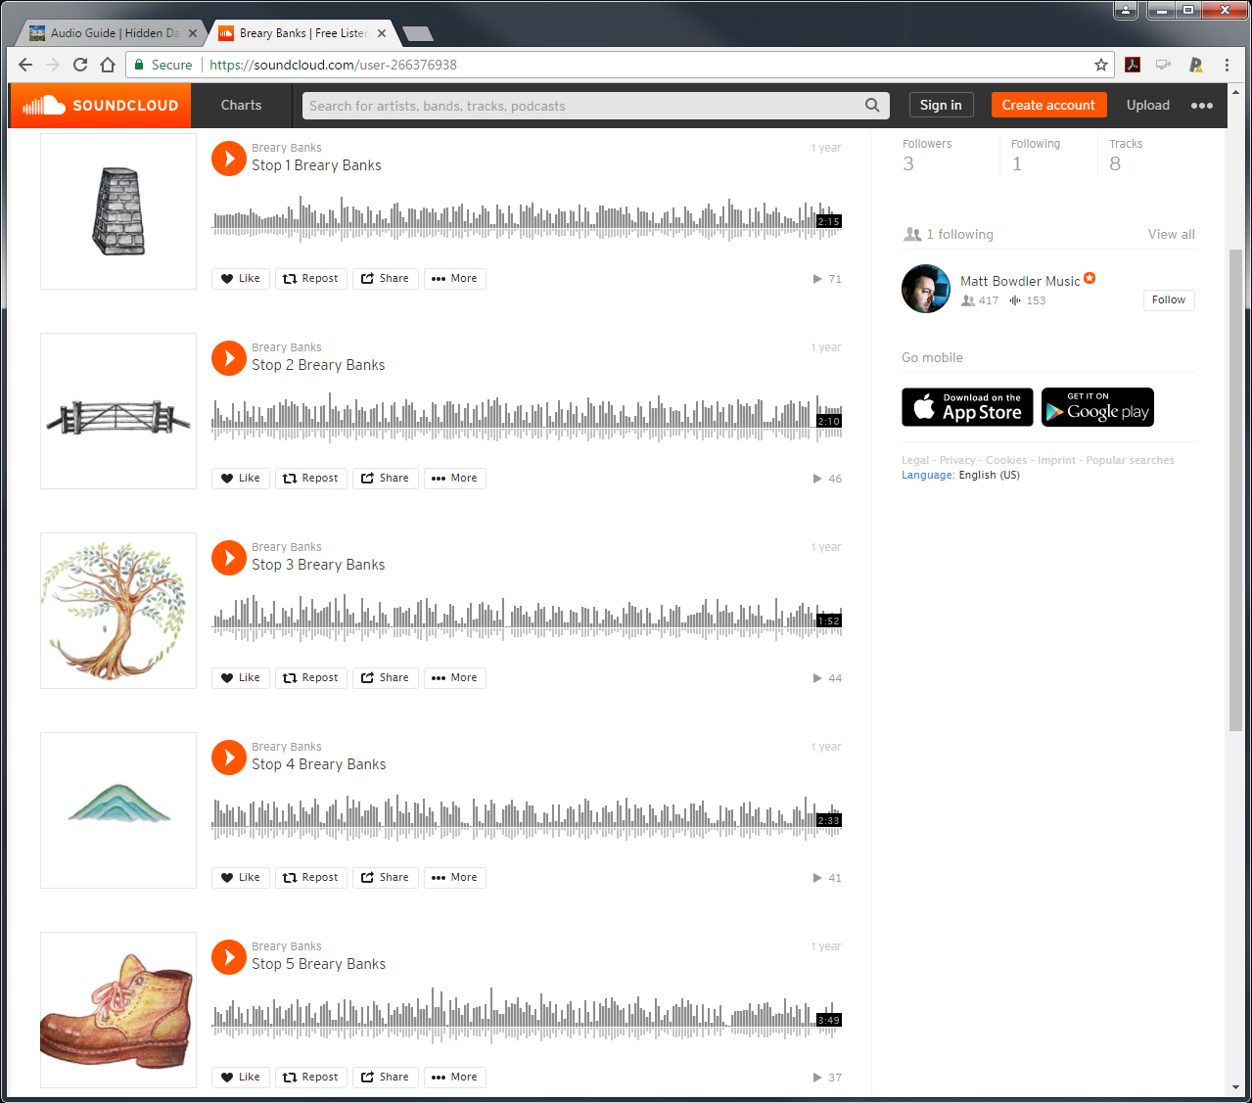
Heritage Practice
Audio guide and digital brochure
https://hiddendale.wordpress.com/breary-banks-audio-guide/
Notes:
https://hiddendale.wordpress.com/breary-banks-audio-guide/

Slide 13
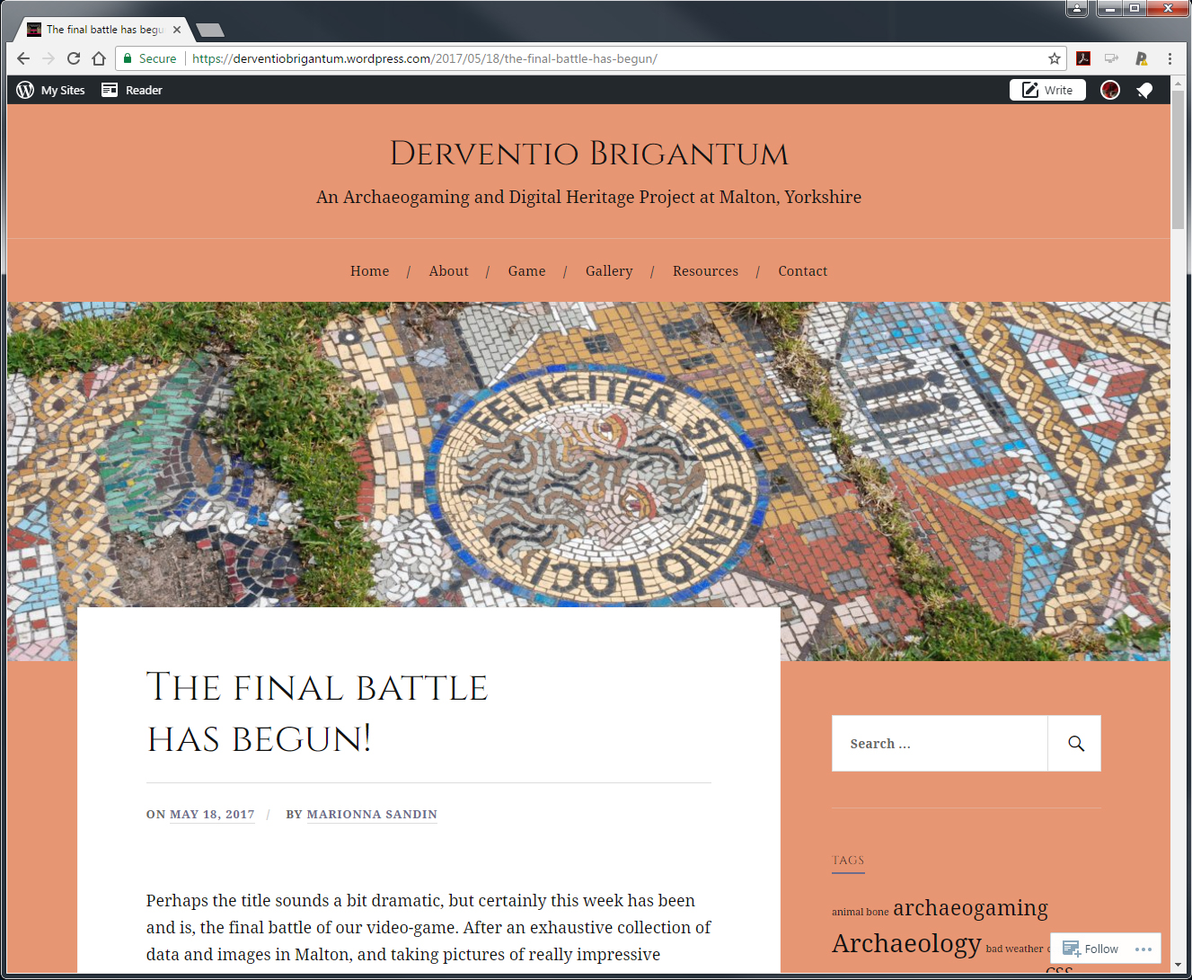
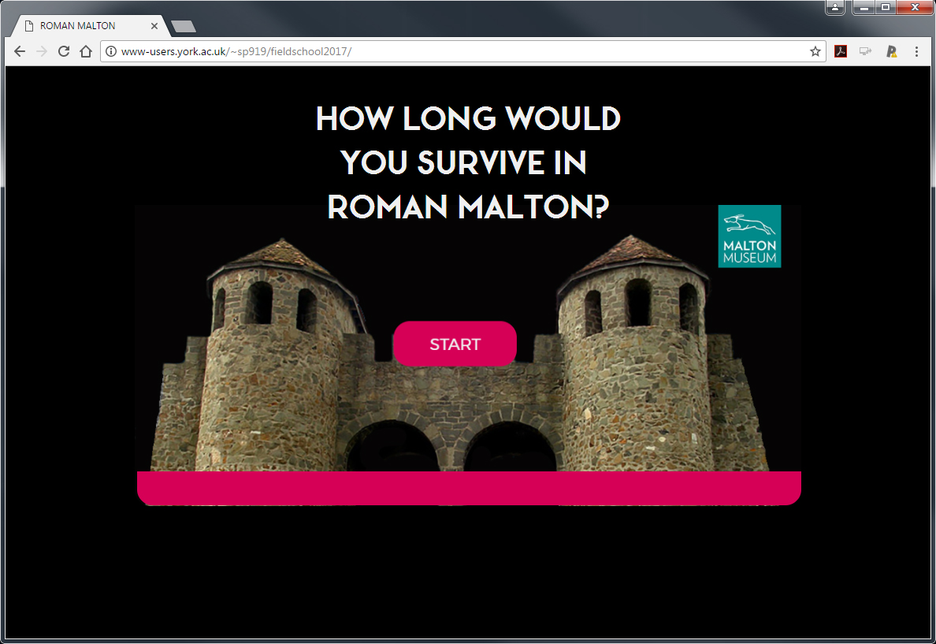
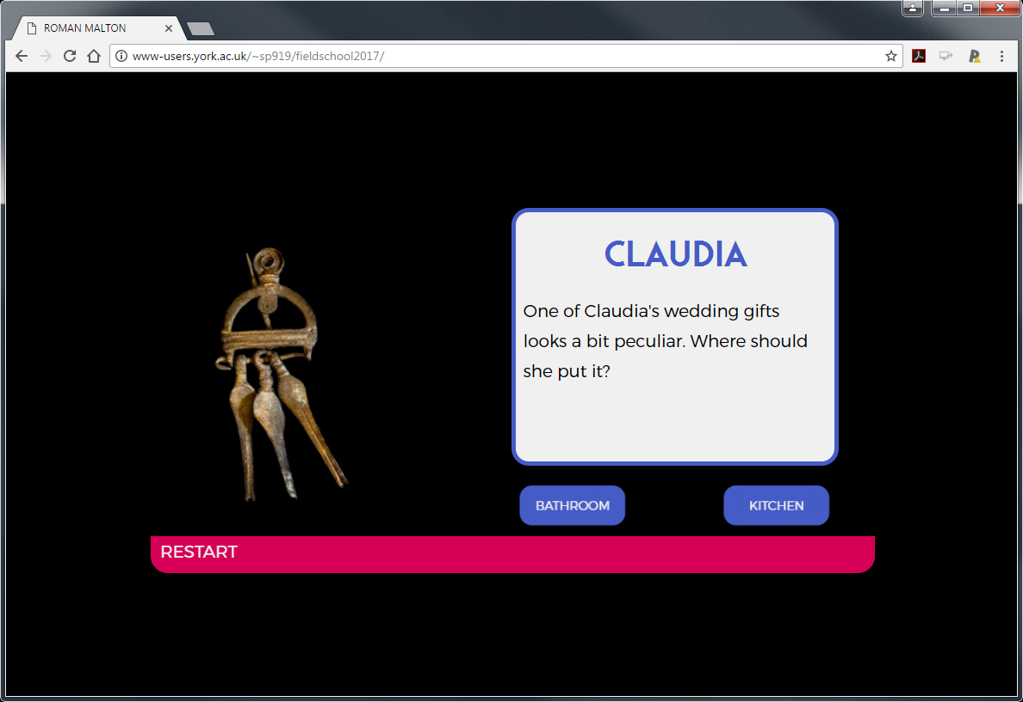
Heritage Practice
Video game
http://www-users.york.ac.uk/~sp919/fieldschool2017/
https://derventiobrigantum.wordpress.com/game/
Notes:
http://www-users.york.ac.uk/~sp919/fieldschool2017/ or https://derventiobrigantum.wordpress.com/game/

Slide 14
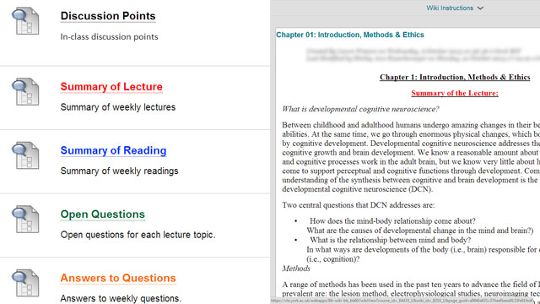
Transforming learning through student-led summary and presentation
Developmental Cognitive Neuroscience (Psychology)
3rd year module (circa 50 students)
  Collaborative summaries and reflection on seminar discussion, lectures and weekly reading
  Student development of MCQs and open questions on topics
  Preparation for student led seminars
Supporting time on task and deeper learning case study
Notes:
Rotational weekly tasks focusing on development of shared resources for weekly student-led seminars. Engagement in instructional tasks such as summarising of weekly lecture and reading was well received by students, contributing to learning process.
https://elearningyork.wordpress.com/learning-design-and-development/case-studies/support-time-on-task-and-deeper-learning-structured-weekly-group-activities-and-collaborative-resource-production/

Slide 15
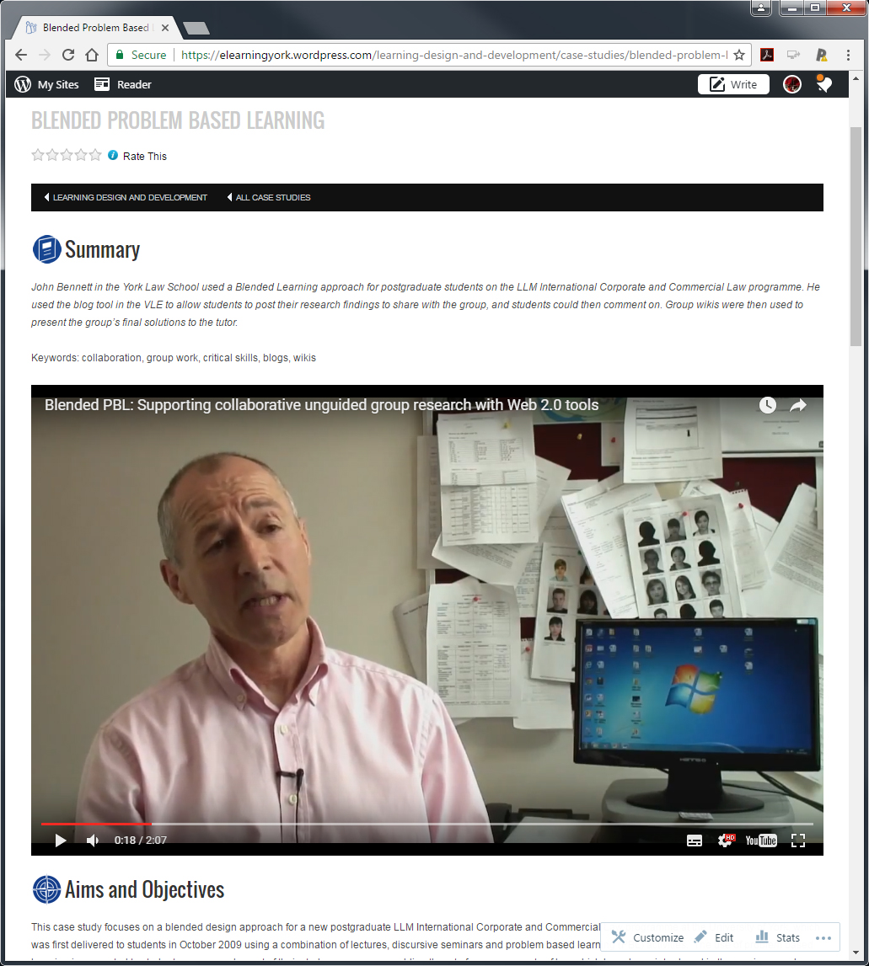
Problem-based learning : Student-led teaching and discovery
York Law School
  shared blog and wiki spaces used by postgraduate law students to perform unguided group research tasks
  enabling groups of students who are geographically dispersed to collaborate online in self-directed learning tasks, researching solutions to the targeted learning outcomes which have been agreed with their PBL tutor
York Law School Blended PBL Case Study
Notes:
Problem-based learning: (student-led teaching and discovery)
York Law School has provided a good example of student-led teaching, based on the use of shared blog and wiki spaces by postgraduate law students to perform unguided group research tasks, as part of a blended problem-based learning (PBL) design. In this context technology has underpinned the PBL cycle, enabling groups of students who are geographically dispersed to collaborate online in self-directed learning tasks, researching solutions to the targeted learning outcomes which have been agreed with their PBL tutor. The choice of task and technology is entirely aligned with the aims of the teaching programme in this respect, in fostering self- and group-management skills expected of students at this level.
https://elearningyork.wordpress.com/learning-design-and-development/case-studies/blended-problem-based-learning/

Slide 16
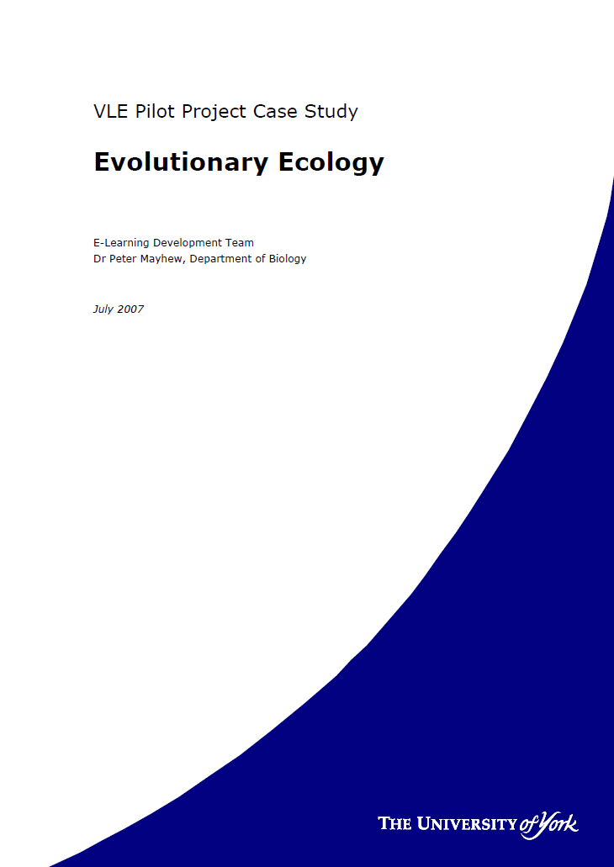
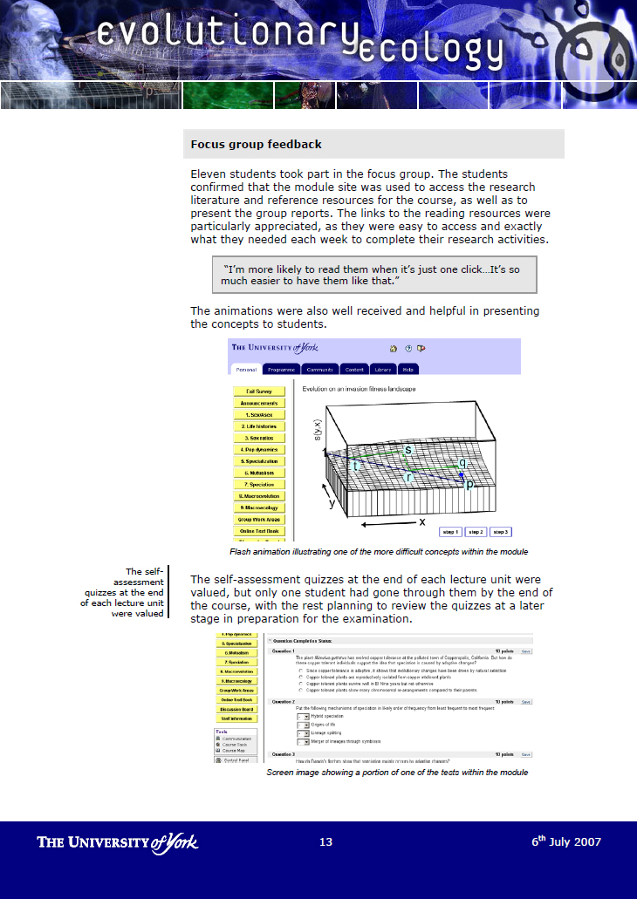
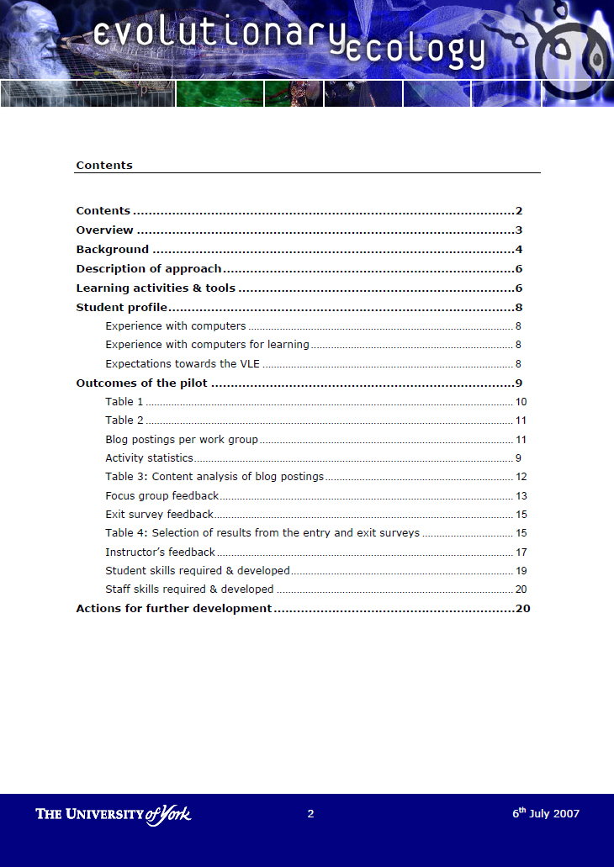
Transforming learning through student-led teaching and discussion
Evolutionary Ecology:
3rd year module
  Collaborative summaries of research literature forming ‘online textbook’
http://tinyurl.com/student-led-teaching
Notes:
Evolutionary Ecology: (student-led content creation)
Transformative learning designs can also offer the potential for students to engage in ‘user-led education’, collaborating with peers and communities within and beyond the classroom to create their own learning resources. Experimentation with user-led knowledge creation tasks has been a feature of blended course design at the University of York, as a way of engaging students in the mastery of key concepts and the evidence base underpinning it, as illustrated in the case study below.
Case illustration: Transforming learning through student-led teaching and discovery (Evolutionary Ecology)
The institutional VLE was used to host course materials including lecture notes and animations to explain key concepts. Students were allocated to small groups (4-5 students) and each group was provided with a blog and a wiki, with viewing and participation rights restricted to that group. Students were required to produce collaboratively a short summary of the research literature on each week’s topic. The blog was used to coordinate activities – allocate work, discuss ways of working, arrange to meet – and the collaborative writing was done in the wiki. Groups were required to present orally their findings in face-to-face sessions. The lecturer provided feedback on the online work. At the end of the course, the best reports were collated by the lecturer in a course level wiki, presented as an ‘online textbook’. This provided students with a valuable revision resource.
https://vle.york.ac.uk/bbcswebdav/institution/E-Learning%20Development%20Team/Internal/Evaluation/Case%20Studies/CaseStudy_EvoEcol_July2007.pdf
http://tinyurl.com/student-led-teaching (pdf)

Slide 17
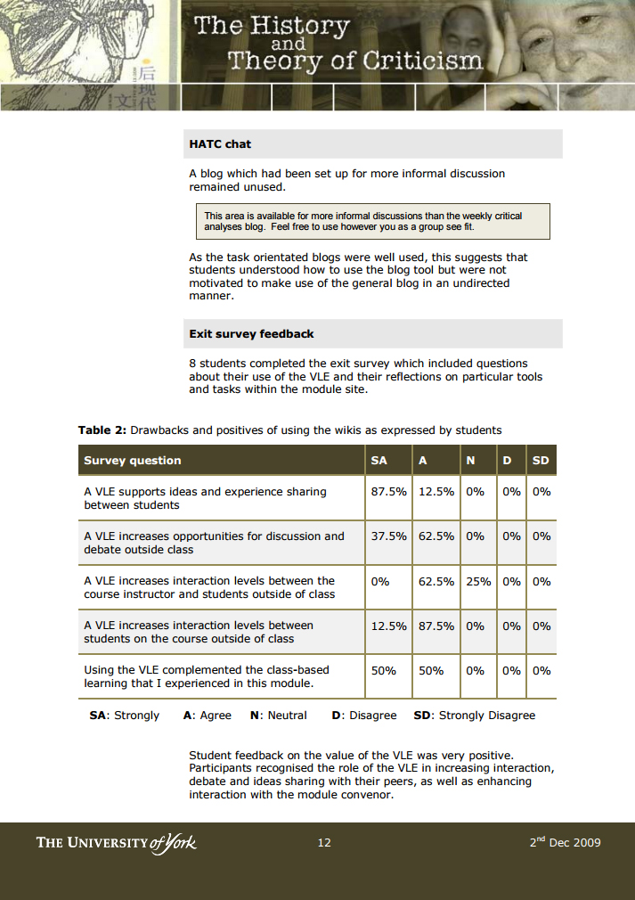
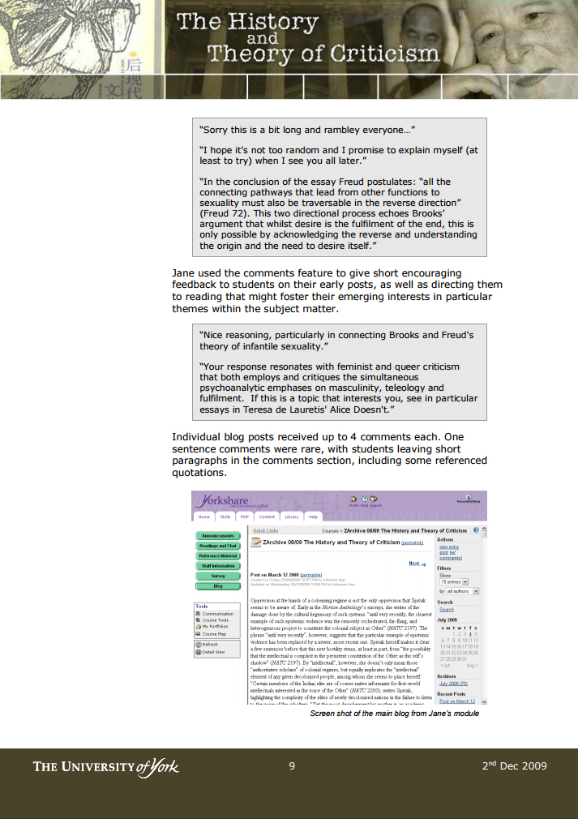
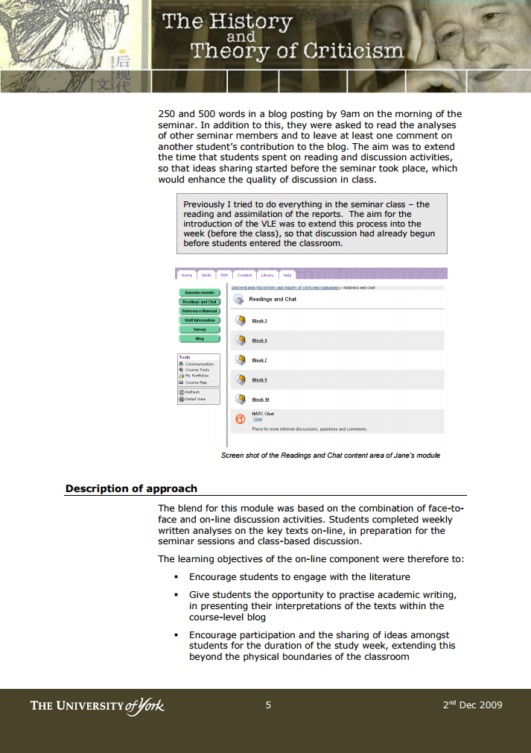
Transforming learning through student-led summary and presentation
The History and Theory of Criticism (English & Related Literature)
3rd year module (circa 10 students)
  Blog posted weekly written analyses on key texts in preparation for seminars and class based discussion
    Encourage engagement with the literature
    Opportunity to practise academic writing
    Encourage participation and sharing
    of ideas between peers extended
    beyond the classroom
The History and Theory of Criticism case study
Notes:
‘by having to create a blog each week it meant that I had to think about the reading, not just absorb it - so in our seminars the discussion already had a depth of understanding which had not been there in many of my other module seminars. It also helped me to keep up the practice of arguing in a written way whilst simultaneously functioning as a starting point for verbal discussion in seminars. I felt that it has contributed substantially to the progress I feel I have made this term in understanding and getting to grips with quite a challenging module.’
https://vle.york.ac.uk/bbcswebdav/institution/E-Learning%20Development%20Team/Internal/Evaluation/Case%20Studies/CaseStudy_HistTheory_Nov2009.pdf

Slide 18
Summary of approaches that have been employed at York
Participation
 | Group Work | Individual Work
Procedural | Developmental Cognitive Neuroscience (Psychology) | Heritage Practice (Archaeology)
 | Evolutionary Ecology (Biology) | Global Literatures (English)
 | The History and Theory of Criticism (English)
 | Britons at Work (English)
Assessed | Introduction to Skills for Studying Education (Education) | MSc Audio Music Technology (Electronics)
 | Engineering Design (Electronics) | Biodiversity & Society (Environment)
 | Business Planning (Management) | First Year Project (Philosophy)
 | Protective Fellowship Scheme (CAHR) | Problem Based Learning (Law)
 | Problem Based Learning (Law) | Current Issues (TFTV)
Task Focus
Notes:
(English – Global Lit) https://elearningyork.wordpress.com/learning-design-and-development/case-studies/supporting-student-development-with-public-blogging/
(TYMS - Business Planning) https://elearningyork.wordpress.com/learning-design-and-development/case-studies/google-tools-for-group-work-business-planning-in-the-york-management-school/

Slide 19
What do you see as the key challenges to ‘designing in’ and supporting student-led learning and teaching activities?
Supporting activities that engage students as active learners; e.g. as co-creators of learning resources / course artefacts

Slide 20
Key challenges associated with student-led learning & teaching activities
Student acceptance of active learning design
Student competencies to engage in target activities
  academic skills: critical reflection & peer review
  technical skills for content creation
  group organisational skills: self-regulation & monitoring
Assessment & feedback design: discrimination between individual and group outputs
‘Join’ between online (student-led) and class-based sessions
Workload: facilitation, monitoring and feedback

Slide 21
Facilitating student-led activities
Phase 1:
Preparation
(design phase)
Phase 3:
Supporting student participation
(early stages)
Phase 5:
Summing up the learning outcomes for the module
(end of module)
Phase 2:
Socialising learners
(start of the module)
Phase 4:
Sustaining student participation
(later stages)
http://bit.ly/ytelhb-4-2 (Walker & Baets, 2008)
Notes:
http://bit.ly/ytelhb-4-2 (Walker & Baets, 2008)

Slide 22
Instructional responsibilities: delivery tips
Socialising: induction – modelling of course tasks and targeted learning behaviour; building confidence & addressing technical and learning competencies
Supporting: just in time instructions; model learning; provide feedback / technical support (tips)
Sustaining: monitoring of work; on-going evaluation & accountability – ‘little and often’
Interlinking and Summing Up: acknowledge and summarise on-line contributions in class; invite class presentations on collaborative work (peer accountability); make explicit learning outcomes from class-based and online activities
Notes:
Attention to:
Rationale: communicating that upfront to students; providing an interesting brief – based on authentic activities that will motivate students to participate and adopt targeted learning methods
Assessment design: attention to individual vs. group contributions & accountability
Enculturation (effective induction) with clarity over expectations of task performance (outputs) and student roles (can be dealt with during induction phase – offering formative feedback after induction / dummy task)
Effective facilitation- getting the balance right: offering reassurance vs. intervention
role of tutor as ‘therapist’ and ‘process oriented supervisor’

Slide 23

Want to know more?
Please refer to sections
4 and 5 of the
York TEL Handbook:
http://bit.ly/ytel-hb
Addressing:
Design of online activities and their relationship to learning objectives; instructional guidance and support to students during the performance of online activities

Slide 24
Case study references
Problem Based Learning
Case study: http://tinyurl.com/blended-PBL
Evolutionary Ecology
Case study: http://tinyurl.com/student-led-teaching
YouTube summary: https://www.youtube.com/watch?v=fiysfbBvWQg
Heritage Practice
Case study: http://tinyurl.com/student-videos-blogging
YouTube summary: https://www.youtube.com/watch?v=A_uAII8n9uI
History and Theory of Criticism
Case study: http://tinyurl.com/critical-literature-review
Developmental Cognitive Neuroscience
Case study: http://tinyurl.com/deeper-engagement

Slide 25
References and recommended reading
Bruns, A. (2006) Towards produsage: Futures for user-led content production. In Proceedings: Cultural Attitudes towards Communication and Technology 2006, eds. Fay Sudweeks, Herbert Hrachovec, and Charles Ess. Perth: Murdoch University, pp. 275-84.
Bruns, A., Cobcroft, R., Smith, J., & Towers, S. (2007). Mobile Learning Technologies and the Move towards ‘User-Led Education’. In Proceedings Mobile Media, Sydney. Retrieved from: http://eprints.qut.edu.au/6625/1/6625.pdf
Dziuban, C., Hartman, J., & Moskal, P. (2004). Blended Learning. EDUCAUSE Center for Applied Research, Research Bulletin, 7, March 30, 2004. Retrieved March 15, 2007 from
http://www.educause.edu/LibraryDetailPage/666?ID=ERB0407
Walker, R. & Baets, W. (2008). Instructional design for class-based and computer-mediated learning: Creating the right blend for student-centred learning. In R. Donnelly & F. McSweeney (Eds.), Applied E-Learning and E-Teaching in Higher Education (pp. 241-261). New York: Information Science Reference.

Slide 27
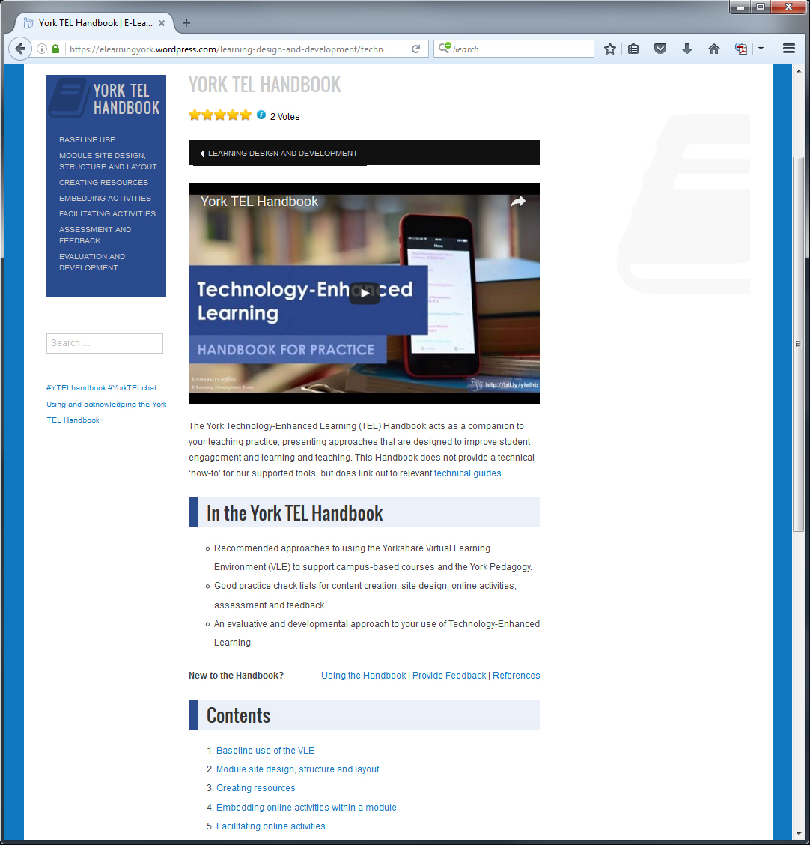
Enabling staff engagement with technology
Programme-level thinking
Focus on supporting active learning through use of TEL tools
Approaches, case studies and advice on choosing the right tool for a learning activity:
  York TEL Handbook:
  bit.ly/ytelhb
bit.ly/ytelhb
Notes:
https://elearningyork.wordpress.com/learning-design-and-development/technology-enhanced-learning-handbook/
bit.ly/ytelhb

