Slide 1




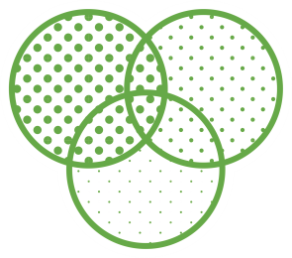




Defining skills training pathways to support progressive development towards our programme learning outcomes
Claire Hughes (c.hughes@york.ac.uk)
Abigail Parrish (abigail.parrish@york.ac.uk)

Slide 2
Knowledgeable & aware
  Have a deep understanding of key concepts and current issues in their discipline
Independent learners
  Effectively find and use sources for information needs
Effective communicators
  Present strong oral and written arguments to a wide range of audiences
Interdisciplinary thinkers
  Naturally work across disciplines to solve current and emerging problems
Our graduates are:
Successful team-players
  Work effectively as part of a team and as a team leader
Creators of new knowledge
  Design and undertake research projects to address key knowledge gaps
Problem solvers
Develop sustainable solutions to environmental, geography and development problems
Analytical
Use cutting-edge tools and approaches to present and analyse datasets

Slide 3
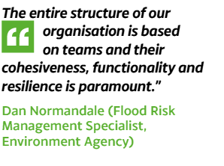
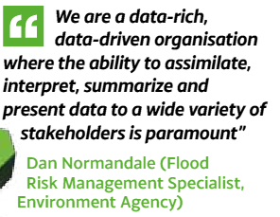
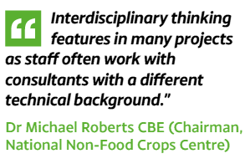
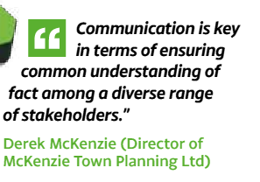
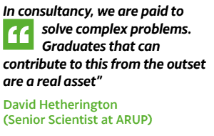
The skills that students develop through our programmes are valued by potential future employers

Slide 4

Our enhancement plan detailed three main improvements to our teaching ……
Our Online Hub allows students to develop key skills in their own time and receive instant feedback on how well they are doing
Skills Training Pathways are embedded into core modules throughout all of our degree programmes
Interactions with potential future employers highlight how student learning can be used in the workplace

Slide 5








Strategic Learning and Teaching Fund Project
In order to support the development of effective skills training pathways in our programmes this project will employ a part-time teaching fellow to:
review our programme mapping information and the educational literature on skills development
work alongside Environment Department staff and students, and the Academic Support Office (ASO), to define effective key skills training pathways that will be embedded into our programmes and used to develop our online skills hub

Slide 6








This session …..
Models of programme-level skills development
Activity 1: Critique some of our proposed models of skills development
Activity 2: Design/ share your own models of skills development

Slide 8
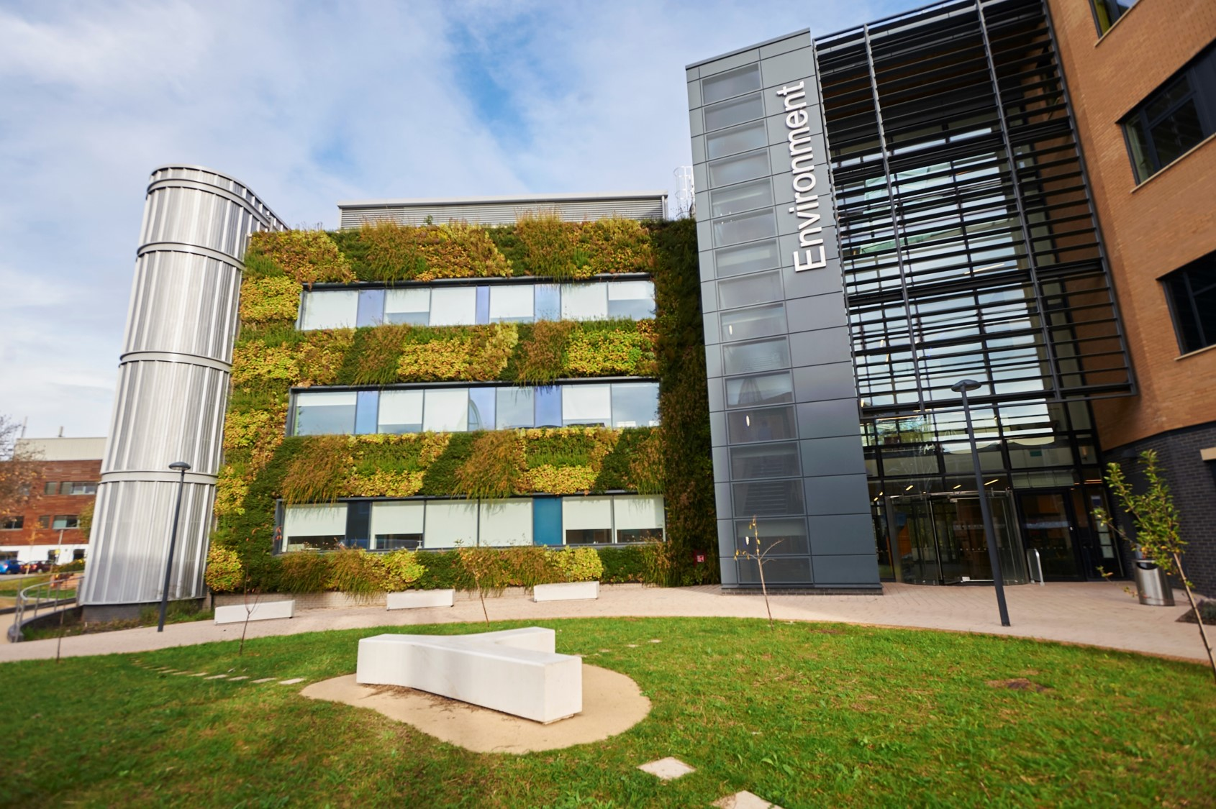
Curriculum models

Slide 9
Possible models for teaching academic skills
Four possible models were considered
Different approaches were chosen for different skills

Slide 10
Stepping stones
Skill 3
Year 3
Skill 1
Skill 4
Skill 2
Year 2
Year 1
See Yeagley, A., Porter, S., Rhoten, M. and Topham, B. (2016). The Stepping Stone Approach to Teaching Chemical Information Skills. The Journal of Chemical Education, 93, 423−428

Slide 11
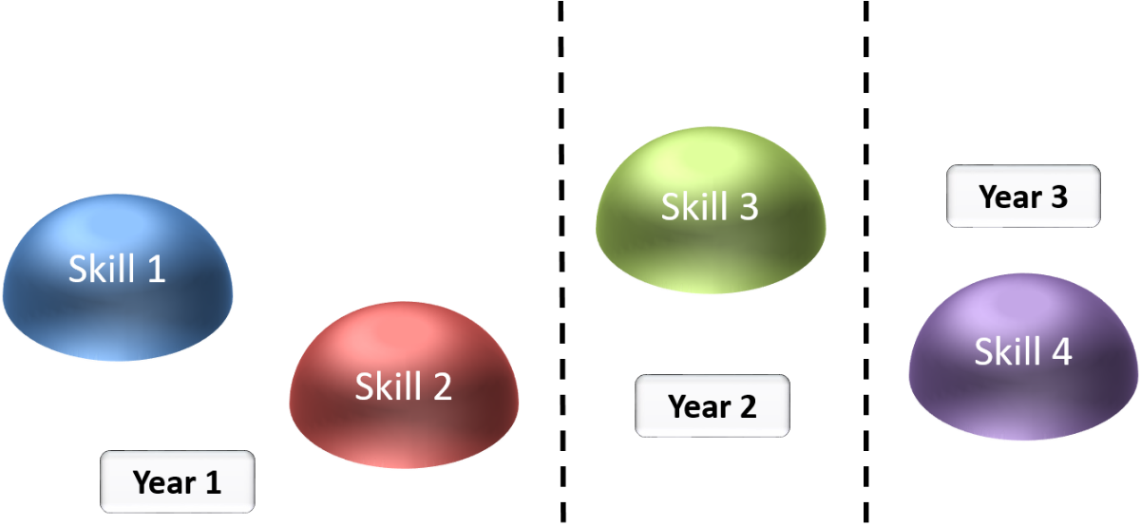
Stepping stones
Yeagley et al. (2016): Stepping stone approach in undergraduate Chemistry degree
1st & 2nd year: finding chemical information in the literature
3rd year: database searching, using abstracts, reference trails
4th year: organising & synthesising information
Effectiveness/outcomes not evaluated

Slide 12
Blocking & interleaving
Blocking
Skill 1
Skill 2
Skill 3
Skill 4
Interleaving
1
2
3
4
2
4
3
1
3
1
2
4
See Taylor, K. & Rohrer, D. (2010). The effects of interleaved practice. Applied Cognitive Psychology, 24, 837–848.

Slide 13
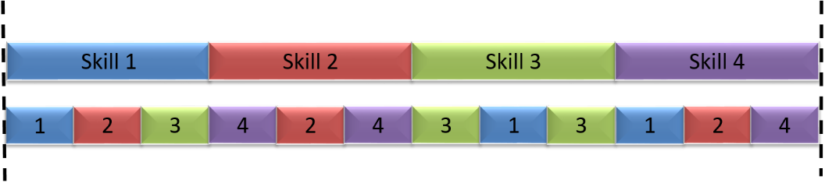
Blocking & interleaving
Taylor & Rohrer (2010): Tested effect of blocked vs. interleaved practice of mathematical problems with children aged 10-11
Practice problem scores were significantly higher after blocked learning, but test scores were significantly higher after interleaving.
Explanation: interleaving also requires understanding of what type of strategy is required to solve a particular problem
Notes:
Implications for practice: in stats, students working on a particular type of test for a set amount of time (blocked learning) might consistently show higher scores in workshop sessions than students working on a range of tests over the same period (interleaving), but interleaving students would show higher scores in exams as they understand when to use each technique.

Slide 14





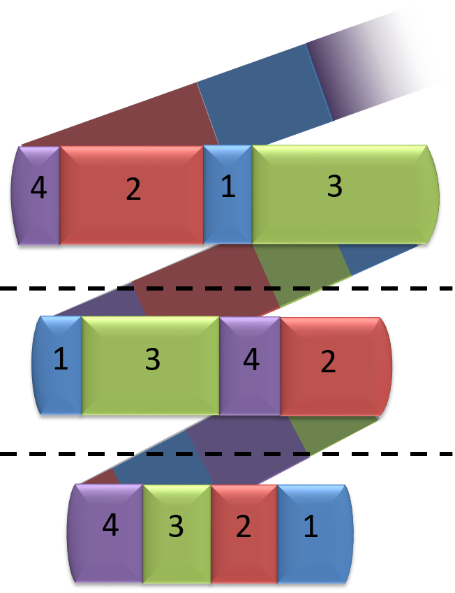
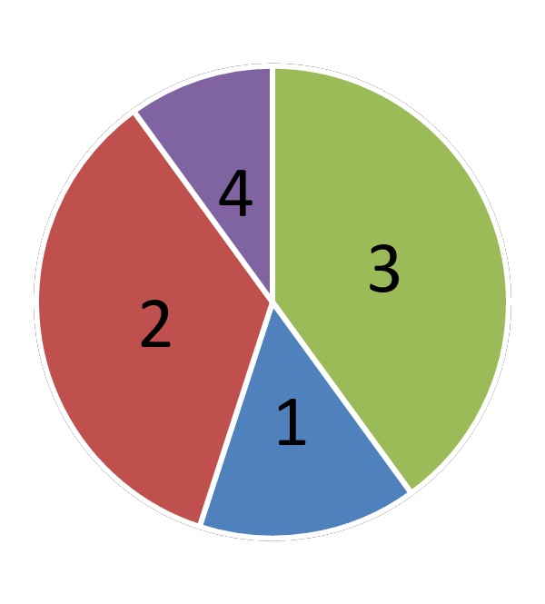



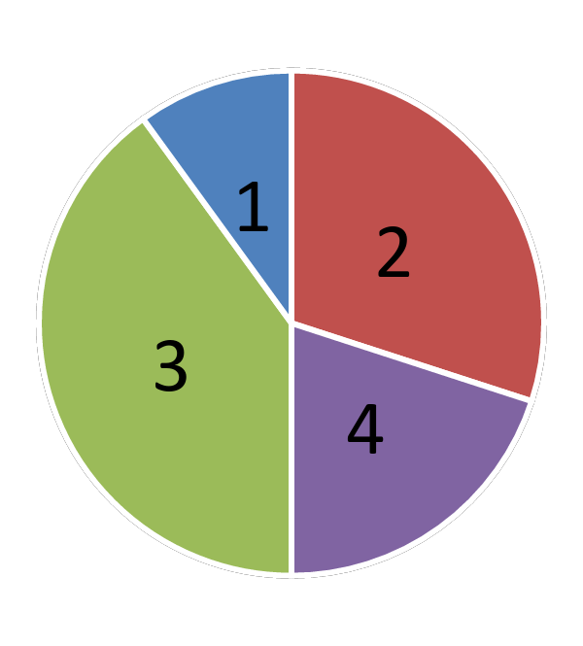
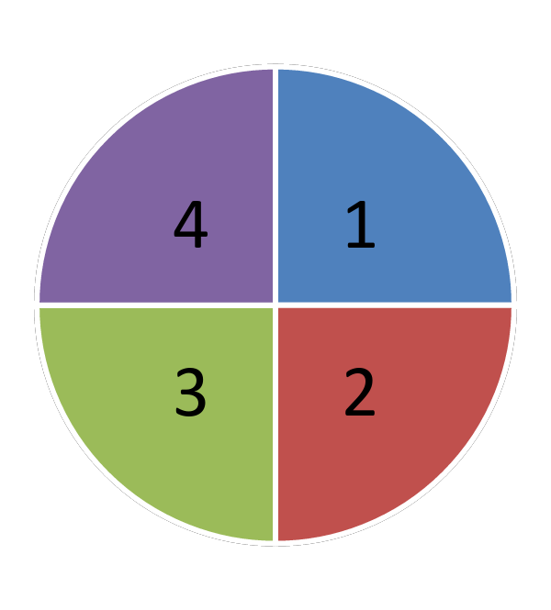
Spiral curriculum
Year 3
Year 2
Year 1
See Bruner, J. (1960). The Process of Education. Cambridge, Massachusetts: Harvard University Press.

Slide 15

Spiral curriculum
Based on work of Bruner (1960)
Frequently used in higher education
Little clear evidence of its effectiveness
Grove et al. (2008) found positive effects on student engagement and enjoyment, but not results (pre-med organic chemistry)
Coelho & Moles (2016): students’ perceptions were positive, although they were initially uncertain (dentistry students)

Slide 16
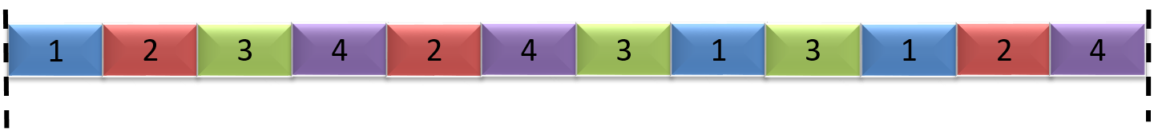

Interleaving vs. spiral
Interleaving mixes up the teaching of different aspects of a skill (1a, 2a, 3a, 4a, 2b, 4b etc.).
A spiral model requires the teaching of each skill more or less in its entirety, but at a higher level each time.

Slide 17
Possible models for teaching academic skills
Different skills require teaching using different models

Slide 18
References
Bruner, J. (1960). The Process of Education. Cambridge, Massachusetts: Harvard University Press.
Grove, N., Hershberger, J. & Bretz, S. (2008). Impact of a spiral curriculum on student attrition and learning. Chemistry Education Research & Practice, 9, 157-162
Taylor, K. & Rohrer, D. (2010). The effects of interleaved practice. Applied Cognitive Psychology, 24, 837–848
Yeagley, A., Porter, S., Rhoten, M. and Topham, B. (2016). The Stepping Stone Approach to Teaching Chemical Information Skills. The Journal of Chemical Education, 93, 423−428

Slide 19
Some proposed models of learning for skills training pathways that sit within a selection of our core modules

Slide 20


Programme learning outcome:
Plan, design and execute research as an individual or as part of a team to address environmental questions and problems using critically-selected field, survey and laboratory methods at appropriate temporal and spatial scales [Creator of new knowledge]
Skill being developed
Modules/ learning activity/ resources
Undertake lecturer-defined research [Modules = Ecological Principles, Fundamental Principles in Environmental Science]
Design sampling strategies [Module = Environment Field Project]
Collecting data in the lab and in the field
Year1
Model of learning:
?
Design, undertake an authentic field project as a group [Module = Environmental Systems Project]
Design and undertake authentic laboratory experiments as part of a group [Module = Ecosystem processes]
Online guidance and tests
Designing research as part of a group
Spiral
Stepping stone
Blocking
Interleaving
Other
Year2
Explanation:
Students become familiar with undertaking lecturer-defined research in year 1. Research design is a black box initially.
The box is unpacked as the students go through the years of study starting at the end of year 1. First as groups and then as individuals.
Designing research individually
Design, undertake an authentic individual project [Module = 3rd Year Research Project]
Online dissertation-specific guidance
Year3

Slide 21

Programme learning outcome:
Obtain, synthesise and critically evaluate complex information on environmental science and related areas from a wide range of reliable sources [Independent learner]
Skill being developed
Learning activity/ resources
Finding and using sources
Training in the use of search engines for findings sources, initial evaluation and formatting in text citation and bibliographies [Library induction activities]
Online resources and tests providing formative feedback
Year1
Model of learning:
?
Critical analysis of source content
Critical evaluation training [Module = Climate Change]
Online guidance and tests providing formative feedback
Spiral
Stepping stone
Blocking
Interleaving
Other
Year2
Explanation:
Students need to be able to effectively find relevant sources before they can go on to any critical analysis and knowledge gap identification.
Identifying knowledge gaps
Compiling information from sources to establish current knowledge and identify knowledge gaps [Module = 3rd year Research Project]
Online guidance and examples
Year3

Slide 22

Programme learning outcome:
Critically analyse and interpret quantitative data using appropriate scientific and technological information and tools such as geographical information systems (GIS) and statistical packages to draw meaningful conclusions from research in the field of environmental science [Analytical]
Skill being developed
Learning activity/ resources
Handling datasets
Using stats programmes
Understand stats tests
Training in use of Excel and SPSS, and lectures and computing practicals on using stats tests for analysing specific datasets [Module = Data Analysis for Environmental Research]
Online guidance documents
Year1
Model of learning:
?
Designing a data analysis strategy as part of a group
Incorporate data analysis into research project design and undertake analysis of an authentic dataset as part of a group [Module = Environmental Systems Project]
Online statistics decision trees and online tests providing formative feedback
Spiral
Stepping stone
Blocking
Interleaving
Other
Year2
Explanation:
Students need to gain skills in handling datasets (e.g. using spreadsheets and stats programmes) before they can progress on to designing a data analysis strategy.
They then need to understand how to use stats decision trees before going on to undertake data analysis within the dissertation.
Designing a data analysis strategy for an individual project
Incorporate data analysis into research project design and undertake analysis of an authentic dataset as an individual [Module = 3rd year Research Project]
Online statistics decision trees and dissertation-specific guidance
Year3

Slide 23
Activity 1: What do you think about the pathways of learning that we have presented?
[10 minutes discussion, 10 minutes feedback]
Consider the information on handout as groups
Creator of new knowledge
Independent learner
Analytical

Slide 24








Activity 2: Design/share programme-level skills training pathways for your own programmes
[10 minutes discussion, 10 minutes feedback]
Step 1: Identify PLO or skill
Step 2: Identify the most appropriate programme-level model for developing that skill
Step 3: Explain why the model is most appropriate and think about how it would work within your programme/s

Slide 25
Programme learning outcome:
Skill being developed
Learning activity/ resources
Year1
Model of learning:
?
Spiral
Stepping stone
Blocking
Interleaving
Other
Year2
Explanation:
Year3

Slide 26
Thank you for participating in our workshop!
Do you have any further comments?
Claire Hughes (c.hughes@york.ac.uk)
Abigail Parrish (abigail.parrish@york.ac.uk)

Slide 28
Programme learning outcome:
Plan, design and execute research as an individual or as part of a team to address environmental questions and problems using critically-selected field, survey and laboratory methods at appropriate temporal and spatial scales [Creator of new knowledge]
Skill being developed
Modules/ learning activity/ resources
Undertake lecturer-defined research [Modules = Ecological Principles, Fundamental Principles in Environmental Science]
Design sampling strategies [Module = Environment Field Project]
Collecting data in the lab and in the field
Year1
Model of learning:
?
Design, undertake an authentic field project as a group [Module = Environmental Systems Project]
Design and undertake authentic laboratory experiments as part of a group [Module = Ecosystem processes]
Online guidance and tests
Designing research as part of a group
Spiral
Stepping stone
Blocking
Interleaving
Other
Year2
Explanation:
Students become familiar with undertaking lecturer-defined research in year 1. Research design is a black box initially.
The box is unpacked as the students go through the years of study starting at the end of year 1. First as groups and then as individuals.
Designing research individually
Design, undertake an authentic individual project [Module = 3rd Year Research Project]
Online dissertation-specific guidance
Year3

Slide 29
Programme learning outcome:
Obtain, synthesise and critically evaluate complex information on environmental science and related areas from a wide range of reliable sources [Independent learner]
Skill being developed
Learning activity/ resources
Finding and using sources
Training in the use of search engines for findings sources, initial evaluation and formatting in text citation and bibliographies [Library induction activities]
Online resources and tests providing formative feedback
Year1
Model of learning:
?
Critical analysis of source content
Critical evaluation training [Module = Climate Change]
Online guidance and tests providing formative feedback
Spiral
Stepping stone
Blocking
Interleaving
Other
Year2
Explanation:
Students need to be able to effectively find relevant sources before they can go on to any critical analysis and knowledge gap identification.
Identifying knowledge gaps
Compiling information from sources to establish current knowledge and identify knowledge gaps [Module = 3rd year Research Project]
Online guidance and examples
Year3

Slide 30
Programme learning outcome:
Critically analyse and interpret quantitative data using appropriate scientific and technological information and tools such as geographical information systems (GIS) and statistical packages to draw meaningful conclusions from research in the field of environmental science [Analytical]
Skill being developed
Learning activity/ resources
Handling datasets
Using stats programmes
Understand stats tests
Training in use of Excel and SPSS, and lectures and computing practicals on using stats tests for analysing specific datasets [Module = Data Analysis for Environmental Research]
Online guidance documents
Year1
Model of learning:
?
Designing a data analysis strategy as part of a group
Incorporate data analysis into research project design and undertake analysis of an authentic dataset as part of a group [Module = Environmental Systems Project]
Online statistics decision trees and online tests providing formative feedback
Spiral
Stepping stone
Blocking
Interleaving
Other
Year2
Explanation:
Students need to gain skills in handling datasets (e.g. using spreadsheets and stats programmes) before they can progress on to designing a data analysis strategy.
They then need to understand how to use stats decision trees before going on to undertake data analysis within the dissertation.
Designing a data analysis strategy for an individual project
Incorporate data analysis into research project design and undertake analysis of an authentic dataset as an individual [Module = 3rd year Research Project]
Online statistics decision trees and dissertation-specific guidance
Year3

