Slide 1
York Learning and Teaching Conference 2017 - TESTA
Lucy Hodgetts

Slide 2
What is TESTA?

Slide 3
What is TESTA?
‘Transforming the Experience of Students Through Assessment’
HEA-funded / National Teaching Fellowship Project
100 programmes in 40 UK universities, and in Australia, India, and USA
Method to assess the current assessment and feedback situation
Actively involves students and programme teams
www.testa.ac.uk

Slide 4
“TESTA maps programme-level data from programmes in universities. This provides a rich picture of assessment - the quantity of assessment, balance of formative and summative, variety, distribution of assessment and its impact on student effort, feedback practices, the clarity of goals and standards, and the relationship between these factors and students’ overall perception of their degree. Using this baseline data, programme teams are devising targeted interventions to address specific programme-level assessment issues.”
Gibbs, G., Jessop, T., El-Hakin, Y. 2010. TESTA Manual: a practical guide to improving student learning.

Slide 5
TESTA Aims
Aim: ‘to identify study behaviour, [and] generate assessment patterns to foster deeper learning across whole programmes’ (TESTA website)
Reviewing our practices in this area will enable consideration of:
- the effectiveness of assessment and feedback design
- the balance between formative and summative assessment
- the workload, for both students and staff

Slide 6
Method
We ‘map’ the expectations of student work then explore this with students
This informs the exploration of the key principles of the York pedagogy

Slide 7
Step 1 | Training and preparation Ethical clearance Training workshop Meet with department to clarify the approach and requirements Work with departments to schedule implementation
Step 2 | Map of Work Work with programme leader to map A&F in programme | Step 3 | Review of Work Questionnaires Administered at start of lecture to 2nd and 3rd years | Step 4 | Review of Work Focus groups Run with 2nd and 3rd years (two for each group)
Step 5 | Report Present report to department Explore report in terms of wider pedagogy changes |  | Step 6 | Action Plan Department to develop an action plan for change
Step 7 | Change process Implementation of plans Ongoing support
Step 8 | Impact Re-run questionnaire/focus groups after changes implemented

Slide 8

Scheduling
Short-term (quick, concentrated to year groups/single programmes)
Week 1 - audit
Week 2 - data collection
Week 3 - data analysis
Week 4 - Write and present report to staff and students
Week 5 - discuss/plan enhancements with Pedagogy Contact and
LE team
Long(er)-term (additional programmes, multiple year groups)
Spring term - data collection
Summer term - report writing and presentation to staff. Discuss plans for enhancement.
Notes:
You could do testa in 7 days but really it probably takes a month -

Slide 9
Step 2 - Audit
Audit of programme assessment and feedback
Chairs of the Board of Studies in each department
Maps the balance between summative and formative assessment and the quantity and type of feedback
Carried out by members of the project team (postdocs, pgwts, etc)
Notes:
Sample map

Slide 10
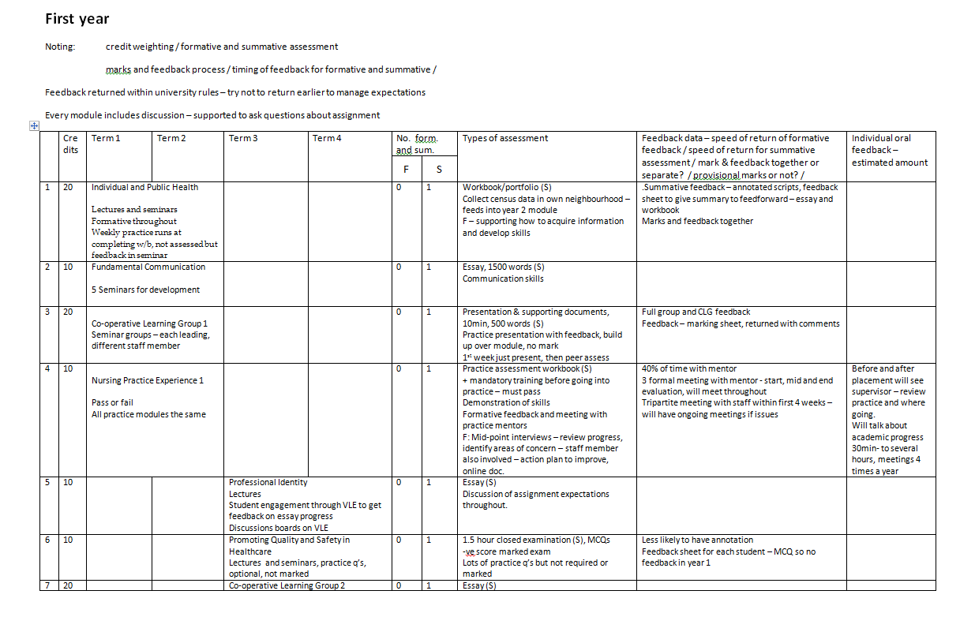

Slide 11
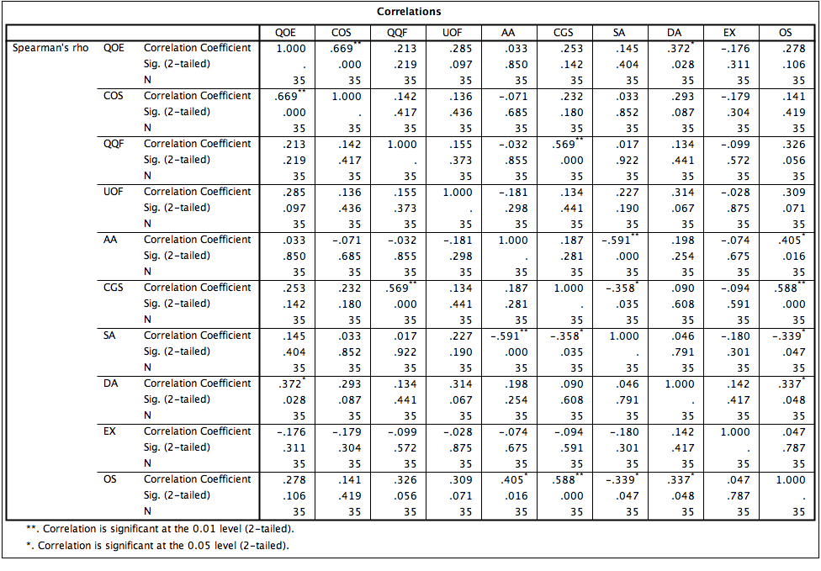
Step 3 - AEQ
“(ii) Coverage of syllabus
Students feel they can be selective about what they need to study (Q4, 5, 11 and 17). 82% disagree that they had to study the entire syllabus to do well in the assessment (Q4); 83% disagree that way assessment worked in the course meant you had to student every topic (Q17); 86% agree the assessment system made it possible to be selective what they studies (Q5); 77% agree it was possible to be strategic about the topics which you could afford to study (Q11).”
Assessment Experience Questionnaire (AEQ) for students
Targets second and third-year students
Designed to measure the extent to which ‘conditions under which assessment supports learning’ are met
Administered in lectures, or online
Data fed through SPSS
Notes:
Sample

Slide 12
Step 4 - Focus Groups
Focussing on how the ‘assessment and feedback patterns in the programme affect student learning behaviour’
Targets second and third year students (two for each year group)
Data is transcribed and coded
Ethical clearance, consent forms etc.
Notes:
Sample questions

Slide 13
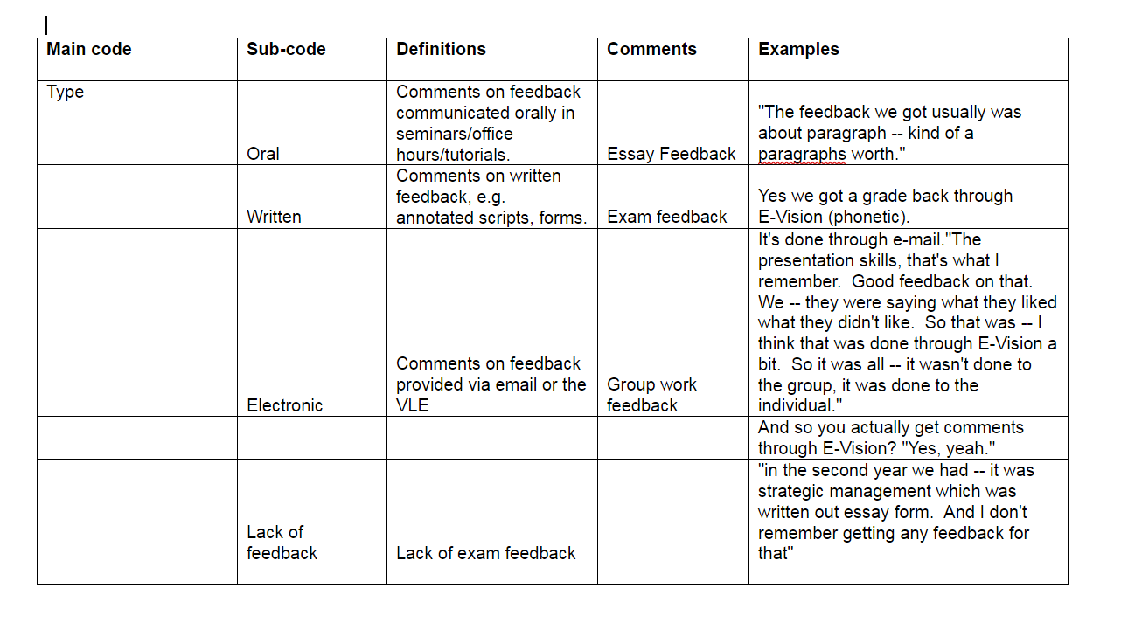

Slide 14
Step 5 - The Report
The results are compiled into a case report which is presented to programme teams
From this evidence and discussion, programme teams then propose and develop changes or interventions to programmes
Notes:
Sample

Slide 15

Discussion > Action Plan
Teaching Committee, BoS, designated meeting
Involvement of the whole department, not just ‘my module’
Generative
Debate, contextualize, criticize, challenge, recognize…
Fresh ideas and conversations
Changes to assessment, pedagogy, structure of the curriculum
Notes:
Something with prog leaders etc
OVerview of the dept as a whole, not just singular modules, but the whole beast

Slide 16
2. TESTA and York Pedagogy

Slide 17
Current take-up
Physics (UG)
Sociology (UG)
Education (UG)
Electronics (UG)
Environment (UG and PG)
Single honours
Core programme
Most pressing case
Specific year groups
Approval meetings, Rapid Response Fund (£3k), Pedagogy Implementation Fund (£10k).
Notes:
How can it be adapted? But needs to stay broadly comparable.

Slide 18

Possible engagement...
Progression / development
A&F driving student work
Formative / summative balance
Timing of A&F
Diversity of A&F
Contact time
Progression towards PLOs
Notes:
What others can the group think of with their departments?

Slide 19
ASO Involvement
Initial conversations - ProPEL contact, me
Data gathering - the department
Data analysis - the department
Report writing - me/ASO/the department
Feedback - me/ASO
Other resources:
Training for PGWTs/Postdocs
Information workshops for departments
Evaluation

Slide 20
Other outputs
Assimilation into the department:
Departmental staff-meetings, workshops, and away days
Impact beyond the department:
Learning and Teaching Conference, 2017 - ‘The York Pedagogy: Making it Work’
Forum workshops
Case study for Forum magazine

