Slide 1
Improving engagement through student partnerships
Jill Webb
Caroline Chaffer

Slide 2
Agenda
Our challenges
Partnership model
Examples from practice
Share experience and expertise
Our experience
Planning for the future
Challenges, limitations & solutions

Slide 3
The Problem
Final year module where engagement is an issue
Requires a critical approach
Feedback good
Average mark 55%-60%
Some excellent marks but too many students ‘stuck’ at 3rd and 2:2
Notes:
Needed to think differently and needed to identify an approach to that would facilitate this – this led us to student partnerships

Slide 4
Student Partnerships
“ collaborative, reciprocal process through which all participants have the opportunity to contribute equally, although not necessarily in the same ways, to curricular or pedagogical conceptualisation, decision making, implementation, investigation, or analysis “ (Cook-Sather, Bovill and Felton, 2014, 6)
Notes:
Working and learning in partnership heightens an awareness of conflicting priorities and tensions between the different perspectives and motivations of those involved, and it raises challenges to existing assumptions and norms about higher education. Partnership also offers possibilities for thinking and acting differently, and for effecting a fundamental transformation of higher education.

Slide 5
Student Partnerships
“ collaborative, reciprocal process through which all participants have the opportunity to contribute equally, although not necessarily in the same ways, to curricular or pedagogical conceptualisation, decision making, implementation, investigation, or analysis “ (Cook-Sather, Bovill and Felton, 2014, 6)
Notes:
Working and learning in partnership heightens an awareness of conflicting priorities and tensions between the different perspectives and motivations of those involved, and it raises challenges to existing assumptions and norms about higher education. Partnership also offers possibilities for thinking and acting differently, and for effecting a fundamental transformation of higher education.

Slide 6
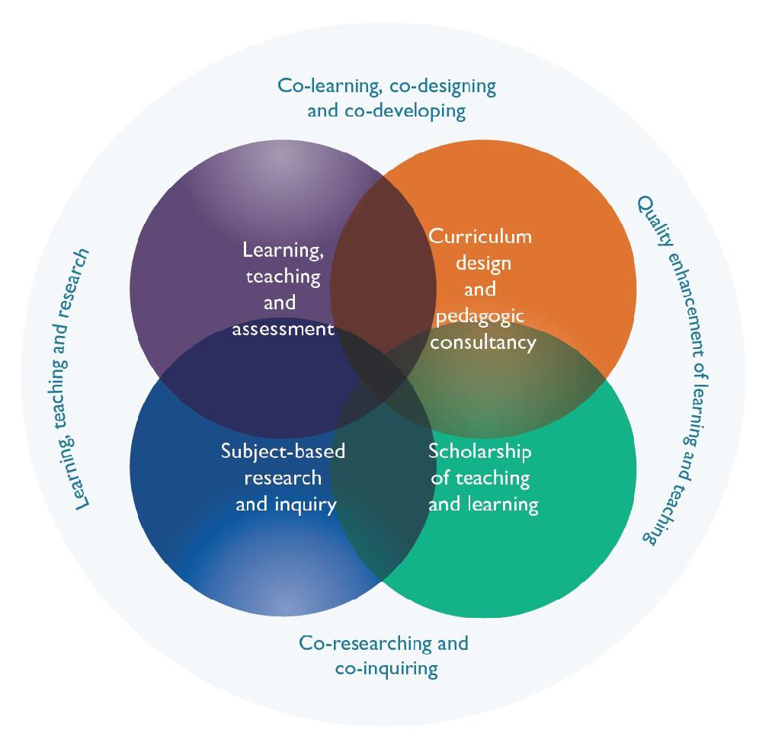
Ways of engaging students as partners in HE
Source: Healey, M. , Flint, A. and Harrington, K. (2014)
Notes:
Left side of the model thinks about using partnerships to enhance learning and teaching and research
Right side – practice and policy

Slide 7
Ways of engaging students as partners in HE
Learning teaching and assessment – active participants
  Students are teachers and assessors in the learning process
  Flipped classrooms
  Internships (3 way partnership)
  Partnerships with the community
  Peer learning schemes
Notes:
Learning, teaching and assessment – Engaging students in partnership means seeing students as active participants in their own learning, and although not all active learning involves partnership it does mean engaging students in forms of participation and helps prepare them for the roles they may play in full partnership. Engaging students as teachers and assessors in the learning process is a particularly effective form of partnership.
Baxter Magolda (2007) has suggested that when active learning is incorporated into a carefully designed curriculum it can speed up the journey of students through the stages of intellectual development towards what she calls the ‘self-authorship’ stage of learning partnership

Slide 8
Ways of engaging students as partners in HE
Subject based research and inquiry
  Elite and mainstream modelling (Healey and Jenkins, 2009)
  Elite – selected number of students working with staff on research projects
  Mainstream – all students engaging in enquiry based learning
Notes:
Whether it involves selected students working with staff on research projects or all students on a course engaging in inquiry-based learning, there is much evidence of the effectiveness of this approach in stimulating deep and retained learning.
Students not reciepents of knowledge but co-constructors – more students involved in producing research/designing inquiry. Levy’s inquiry based approach

Slide 9
Ways of engaging students as partners in HE
Scholarship of teaching and learning
  Engaging with students as ‘change agents’ for faculty or university initiatives
  One off projects
Curriculum design and pedagogic consultancy – going beyond module and course feedback
  Students developing learning resources
Notes:
Students are commonly engaged in course evaluations and in departmental staff-student committees, but it is rarer for institutions to go beyond the student voice and engage students as partners in designing the curriculum and giving pedagogic advice and consultancy. Yet where institutions have implemented such initiatives they have seen significant benefits for both students and staff.

Slide 10
The benefits…
Engagement: its active, buildings relationships and a sense of belonging
Improves critical thinking ability – knowledge is contextual and uncertain:
  Knowledge is socially constructed with tutors and peers
  Co-construction of knowledge involves recognising multiple perspectives
  Validates students as knowers and not as passive consumers
Creates dissonance: challenging, forces students to think and examine their own beliefs this can be uncomfortable but can be a catalyst for development

Slide 11
Breakout
How have you used partnership approaches in your own teaching or across courses which you have been involved with?

Slide 12
First steps toward using partnership more extensively…
Identify partnership informed practice
  Peer review
  1-1 discussion of plan
Independently run focus group sessions with outgoing students
3 areas for development:
  Pursuit of own interests
  Students value dialogue with each other and tutors but need more support
  Students value challenge

Slide 13
Pursuit of own interests
Tailoring the curriculum and assessment?
Would have been interested in working on a topic I had chosen
It’s easy to read something you enjoy; it comes easily
Writing your own question is a good idea but I’d give myself too much scope!
Front load all lectures – 1st 4 weeks
Choose from 2 topics
Later seminars tailored to topics
You could ruin an essay with a bad question.

Slide 14
Dialogue
Interaction with peers and tutors
The 1:1 essay plan forced me to do some work and really made me think
The module prompts discussion of different views, and that’s why it’s interesting
Only 2 or 3 people have done the reading
Later seminars tailored to topics
Realistic preparation target
Scaffolded preparation
Co-write rules of the game
Seminars co-taught
Model good dialogue
Larger seminars
I didn’t feel I understood the assessment criteria well enough to do the peer review
You don’t have to attend everything

Slide 15
Rising to the challenge
Seminars linked to specific skills so we could learn if we were on the right track
Content isn’t taught – we have to read things and think for ourselves and then discuss it.
You become more critical and understand what being critical is.
It’s scary
Engage in a low risk manner - scaffolding
Focused seminars
Focused formative
The reading is difficult and its time wasted if you’re not doing the essay
We need more help with criticality and writing; be more specific

Slide 16
Summary
Partnership lens
    Listen/consult (properly) – it’s not just feedback
    Led us to think about our relationship with our students
Next steps
    Empty seminars and lab seminars!
    Identify students as lead consultants

Slide 17
Break out
How might you use partnership approaches?
What are the barriers to further development and how might you overcome them?

Slide 18
References
Baxter Magolda, M. B. (2007) Self-authorship: The foundation for twenty-first century education. In Meszaros, P. S. (Ed.) Self-authorship: Advancing students’ intellectual growth. New Directions for Teaching and Learning.109, 69– 83.
Cook-Sather, A., Bovill, C. and Felten, P. (2014). Engaging students as partners in learning and teaching: A guide for faculty. London, John Wiley & Sons.
Healey, M. , Flint, A. and Harrington, K.(2014). Engagement through partnership: Students as partners in teaching and learning in higher education. [On-line] Available at: https://www.heacademy.ac.uk/engagement-through-partnership-students-partners-learning-and-teaching-higher-education. [Accessed 14 May 2017].
Sambell and Graham (2010) Towards an assessment partnership model? Students’ experiences of being engaged as partners in assessment for learning enhancement activity. In: Little, S. ed., Staff-student partnerships in higher education. London. Bloomsbury Publishing.

