Slide 1
To boldly go: Creating Inclusive Learning and Teaching Environments
Claire Shanks – Open Door and Disability
Liz Waller – Information Services
Maria Ayaz – Equality and Diversity

Slide 2
Aims and Objectives
Gain an understanding of what ‘Inclusive Learning and Teaching (ILT)’ means
Consider how you can apply ILT to your current teaching practices
Gain an understanding of Universal Design for Learning
Share good practice with colleagues
Learn from colleague’s experiences
Notes:
Colleagues will be able to evaluate and reflect where you are with your current teaching practices
If teaching is exciting we know students will be better engaged, have a deeper learning experience and achieve better outcomes
2000 - The first significant indication of the need for attention to be given to the challenges faced by disabled students resulting from curriculum design and pedagogical approaches in the UK
2006 – HEFCE special initiatives: Towards Inclusive Learning in Higher Education: Developing Curricula for Disabled Students (Mike Adams and Sally Brown)
2015 - Universal Design in Higher Education: From Principles to Practice by Sheryl Burgstahler. An updated collection of papers outlining how universal design for learning (UDL) has made progress in North America since 2000
2016 – Universal Design for Learning: Best Practice Guideline (The outcome of an EU-funded project led by UNIVERSELL in Norway which contains 80 pages of practical help for those seeking to promote and implement UDL)

Slide 3
Question 1
What does inclusive learning and teaching mean to you?

Slide 4
Academic perspective of inclusive learning and teaching
University of Leeds
Notes:
Key points from video:
ILT is the what and how we do it
Interactions, design, delivery of modules and programmes, reflection, enhancement and improvements
Resources – blended learning and digital technology
Creating and adapting resources
Environment
Student journey at the centre of ILT – from first interaction to transition into employment or further study

Slide 5
‘DSA papered over the cracks of University non-compliance with the Equality Act.’
David Willets, 2015
“Much of what’s been funded [by DSAs] actually constitutes reasonable adjustments under the Equality Act and are therefore legally your responsibility as a University.’
BIS
Notes:
What are the key drivers for changes?
Removal of DSA funding: rebalance responsibilities back onto HEIs.
DSA fund was to provide enablers (boxes) to allow students with disabilities to have equal chance of participating and experiencing learning
January 2017 – ‘Inclusive Teaching and Learning in Higher Education as a route to excellence’ published by the Government:
Shift away from supporting individual learners, individual support needs becomes the exception rather than the rule
Need to develop a more strategic and flexible approach to delivering inclusive practice
Inclusive practice benefits HEIs:
Remediate key issues around differential outcomes for students from different backgrounds (core to TEF, QAA expectations and in Access Agreements)
Equality Act 2010 and DSAs
Cost saving - DMU, cost of individual support reduced from £5.2m to £120k
Reputational enhancement

Slide 6
Universal Design for Learning
A set of principles for curriculum development that give all individuals equal opportunities to learn
A pedagogical blueprint for developing Learning, Teaching and Assessment methods and materials that work for all
Not a single ‘one-size-fits-all solution’ but rather flexible approaches that can be adjusted for individual needs
This adjustment is often made by the learner
Notes:
UDL term has been defined in US legislation as a ‘scientifically valid framework for guiding educational practice that provides flexibility in the ways information is provided, in the ways students respond or demonstrate knowledge and skills, and in the way students engaged.
Moving towards UDL means challenging the status quo of the traditionally advantaged learner and a pedagogy based almost entirely on text based learning. Inclusive learning and teaching recognises all students' entitlement to a learning experience that respects diversity, enables participation, removes barriers and anticipates and considers a variety of learning needs and preferences.
UDL is not a disability thing
UDL is removing barriers for all individual learners
A relatively new way concept in HE that means we have to change how we think about universal practice so that a greater diversity of students is included in HE, including those with a disability.
Reduce barriers
Encourage participation
Opportunities for all
Looking at anticipatory and reasonable adjustments
Norway – since 2014, requires application of universal design in terms of education, environment, transport and ICT. Universal design is an enforceable legal standard.

Slide 7
Universal Design for Learning
Multiple Means of Representation “WHAT”
Multiple Means of Expression “HOW”
Multiple Means of Engagement “WHY”
Flexible Study Resources
Flexible Assessments
Flexible ways of Learning
Notes:
Flexible study resources –
Resourceful, knowledgeable learners
Use of VLE
Learning materials uploaded 48 hours in advance (modifiable format)
Technical language defined clearly
Students encouraged to use scaffolds ( e.g. concept maps, tables and summaries to link ideas)
Various learning resources.
Flexible assessments:
Strategic, goal directed learners
Variety of assessments beside unseen exams
Assessments only testing learning outcomes
Contextualised marking descriptors are clear in advance of assessments
Formative assessments and timely, specific feedback help students to improve and excel
Students are guided to set goals and encouraged to track their own progress
Students encouraged to take risks or make mistakes, but embrace these as a learning opportunity
Flexible ways of learning:
Purposeful, motivated learners
Varied and innovative teaching methods to motivate and engage students
Student encouraged to actively participate in class
Opportunities for group work, collaboration and peer support
Differentiation provides an appropriate balance of support and challenge, with direction to independent study resources
Students supported to be autonomous, resilient and reflective (HEA: Embedding mental wellbeing in the curriculum: maximising success in HE)
Learning is authentic and contextualised, socially and globally relevant

Slide 8
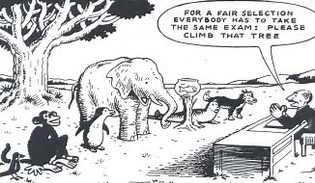
Notes:
Picture – is this competency standard, have we already informed students what is expected

Slide 9
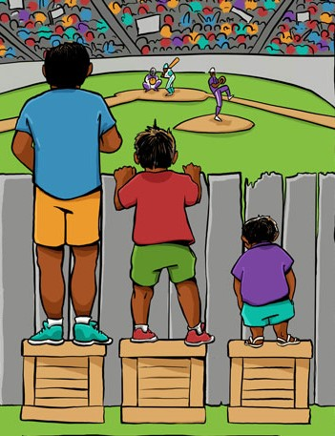
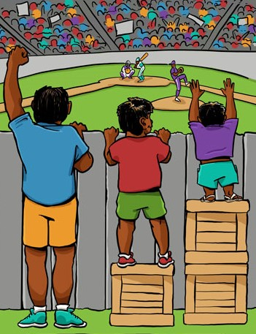
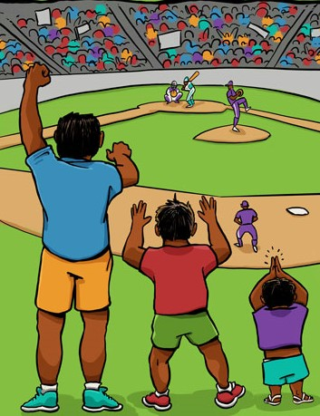
Anticipatory adjustments
Equal
Equitable
This is making reasonable adjustments
to barriers to learning

Slide 10
Café Etiquette
FOCUS ON WHAT MATTERS
CONTRIBUTE YOUR THINKING
SPEAK YOUR MIND AND YOUR HEART
LISTEN TO UNDERSTAND
LINK AND CONNECT IDEAS
LISTEN TOGETHER FOR INSIGHTS AND DEEPER QUESTIONS
PLAY, DOODLE, DRAW – WRITING ON TABLE CLOTHS IS ENCOURAGED
HAVE FUN!

Slide 11
Question 2
Considering your own teaching, how have you applied ILT to your own teaching practice?

Slide 12
Question 3
What tools/support do you need to be able to deliver ILT?

Slide 13
An inclusive approach
Recognises multiple identities
Avoids compartmentalising solutions based on specific ‘need’
Adopts holistic approach to meet entitlements
Student

Slide 14

Inclusive Learning and Teaching Policy – launching in Autumn 2017
Learning Experience Project:
- To review current policy, guidance and resources for supporting disabled students
- To audit the current processes and practices for supporting disabled students
- To map our central and departmental support structures for disabled students
- To identify ways to improve: processes, guidance and resources
- Prepare recommendations for the Disability and Accessibility Group
Consider Universal Design for Learning at York
Notes:
Volunteers for Learning Experience Project

Slide 15
Additional Comments and queries:
Claire Shanks – Claire.Shanks@york.ac.uk
Liz Waller – Liz.Waller@york.ac.uk
Maria Ayaz – Maria.Ayaz@york.ac.uk

